Slide 1
Advocacy 101
Understanding the What, When, How and Why of Advocacy
Will Shaffner
Director Business Development and Government Relations

Slide 2
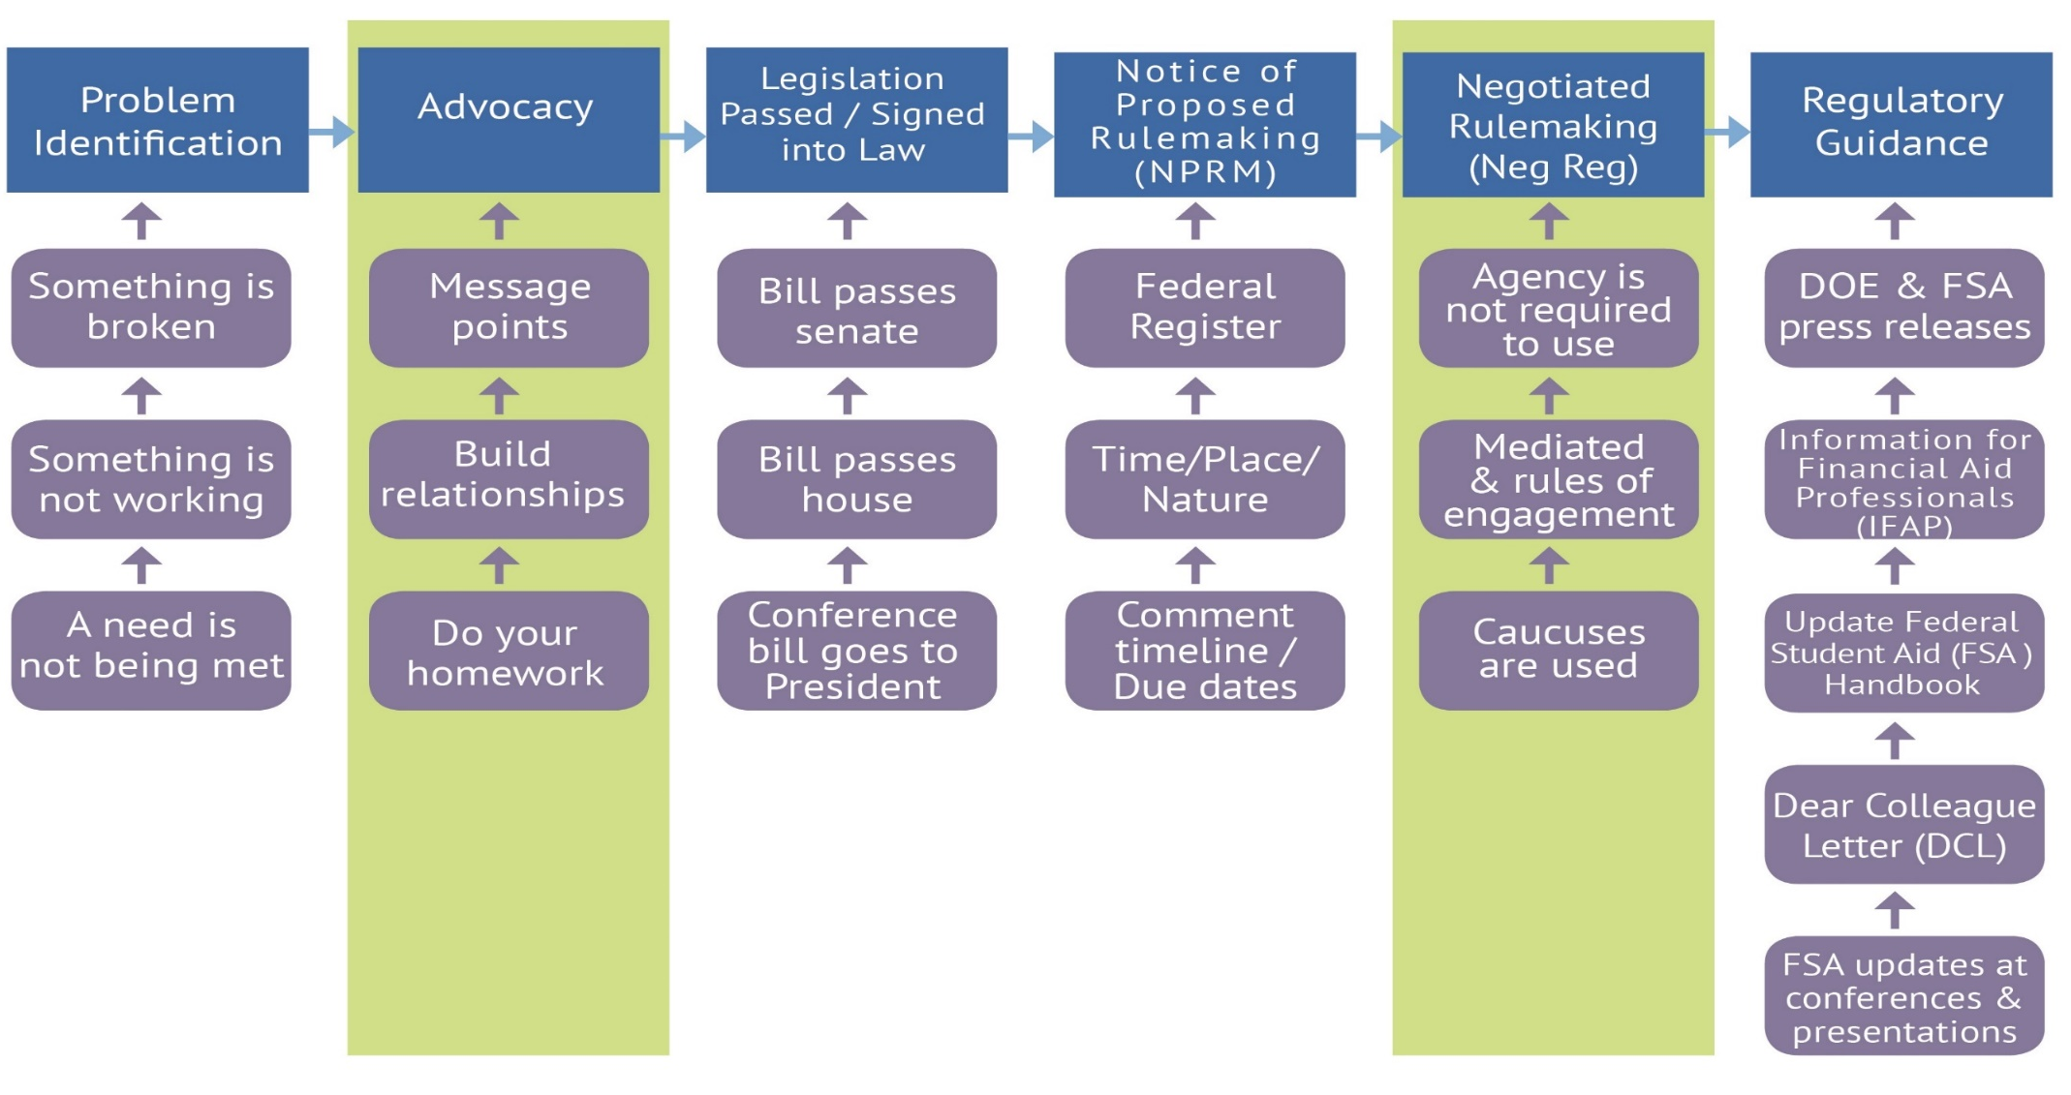
Legislative Life Cycle

Slide 3
Advocacy & Negotiated Rulemaking
What is/isn’t advocacy
Who can advocate
Why do we advocate
Where do we advocate
When do we advocate
How do we advocate
What Next?
Negotiated Rule Making (NegReg)

Slide 4
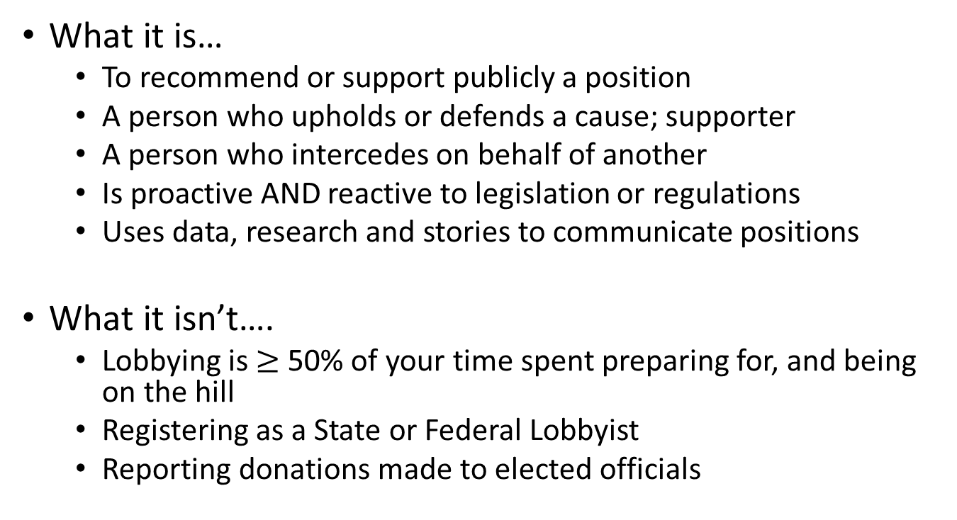
What is/isn’t Advocacy
What it is…
To recommend or support publicly a position
A person who upholds or defends a cause; supporter
A person who intercedes on behalf of another
Is proactive AND reactive to legislation or regulations
Uses data, research and stories to communicate positions
What it isn’t….
Lobbying is $≥$ 50% of your time spent preparing for, and being on the hill
Registering as a State or Federal Lobbyist
Reporting donations made to elected officials

Slide 5
Who Can Advocate
Anyone (yes, you…) can advocate
As a private citizen
As a member of an organization (MASFAA, or a State Association, etc.) with organization’s permission
As an employee (on behalf of your institution) with institution’s permission
Communication/coordination with in-house (on campus) Government Relations Team

Slide 6
Why Do We Advocate
Advocacy efforts may center around these major policy areas:
Increasing access to higher education, including early awareness and outreach
Simplifying student aid systems
Encouraging college persistence & completion
College savings and financial education
Minimizing student indebtedness and emphasizing grant and work aid
Supporting the primacy of need-based aid

Slide 7
Where Do We Advocate
On Campus
State
Federal
Administration
Department of Education
Office of Management and Budget
Congress
House & Senate Education Committees
House & Senate Appropriations Committees
House & Senate Ways and Means
Other Higher Education Associations & Organizations
**Takeaway here: Not just Congress**

Slide 8
When do we Advocate
Continuous
On-Going conversations
Don’t wait until you need something
Relationship development

Slide 9
How Do We Advocate
Develop talking points/priorities
Explain who you are & why you’re important
Be ready to talk – meetings move quickly
Know message and facts
Craft a one-page leave behind
K.I.S.S. – be prepared with more
Use data

Slide 10
How Do We Advocate
Utilize individual examples
Build relationships with staff
Show appreciation through follow up
Keep it local
Keep it concise
Exchange business cards
Not only face-to-face
Social Media
Emails
Letters
Phone calls

Slide 11
Do Your Homework
Who is this 17 y/o kid?
Don’t write them off – ask open-ended questions to gauge familiarity
Research legislators
Party affiliation
Political interests
Role in legislation – sponsor, co-sponsor, committee membership, etc.
How will you structure your request?
How will you make this interesting for them?
How will you build this relationship?
How will the conversation flow?

Slide 12
Advocacy Examples
Consumer disclosure information
Administrative cost allowance
Elimination of crossover regulation for summer Pell
Congressional & State staff orientation
Budget related discussions
Save Student Aid
Financial aid award letter discussions

Slide 13
What Next
Follow up!
Be proactive
Remind staff how they should know you
Go over your points (again)
Thank them for their time
Invite them to contact you in the future
Keep up with your contacts – that is the relationship builder
(plus they move around….a lot…..)
This can be done via email, or with notecards, etc. (personalized is best)

Slide 14
Getting Started
Participate in the MSFAA Leadership Masterclass
Build your network
MSFAA Conference
Mentor
Participate in NASFAA/State Hill Day events
Know your elected officials
Your district
Statewide
Listen to/read the news
Follow issues that impact our profession
Get outside your bubble

Slide 15
Negotiated Rule Making (NegReg)
NegReg is another form of advocacy
Happens after the legislative process or when the Department will issue regulations through a negotiated process with industry and stakeholders
Heads I win. Tails you lose.
If the USDE doesn’t reach consensus with the negotiators, their view is final

Slide 16
How to Prepare for NegReg
Study your topic
Understand the history behind your topic
Try to find out the USDE perspective on the topic
Understand the financial aid community’s perspective on your topic
Try to leave your bias at the door and represent views that will benefit students and the financial aid community

Slide 17
What to Do During Negotiated Rule Making
Articulate your views clearly
Justify your positon with as many facts as possible
Always communicate the impact on students
Avoid, when possible, the impact on workloads
Stand firm on your position, but willing to negotiate – we never get everything we want
Never let your temper get the best of you. When you do, you lose!

Slide 18
After Negotiated Rule Making
If consensus is reached, fantastic! The negotiations were a success.
If consensus not reached:
The USDE can move their position forward in its entirety
The USDE can incorporate certain aspects of the team’s view into the rule and move the regulations forward
Not usually seen, but a new negotiated rule making team can be assembled, or the current team can be sent back to the table, and the process starts over
Negotiated rule making is a form of advocacy for the financial aid community
Never stop standing up for what is right for students and the community

Slide 19
Question and Answer Time
Questions
&
Discussion

Slide 20
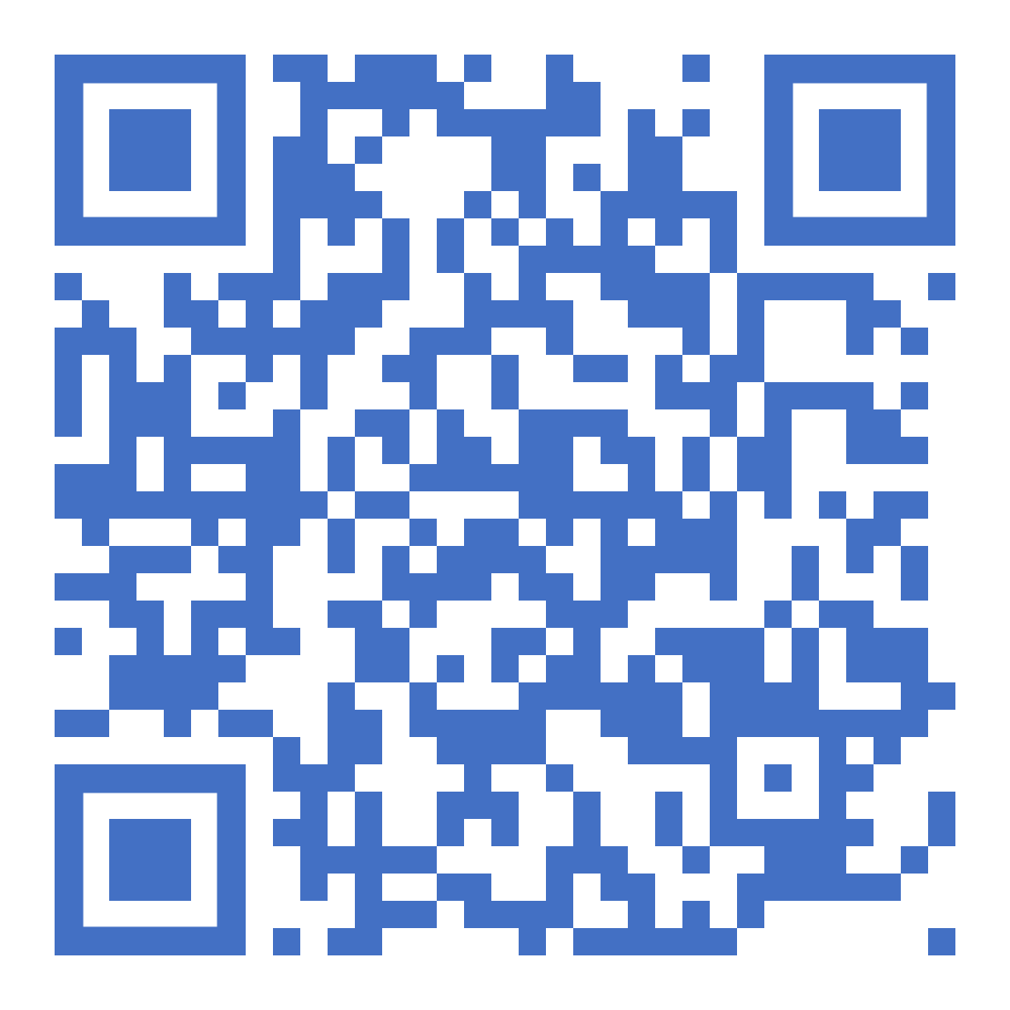
Thank You
Legislative Advocacy 101
Will Shaffner
MOHELA
WillS@mohela.com
(Review this session)

