Slide 1
Prison Education Programs
Reflecting on the Past, Celebrating the Present, Shaping our future together.
2023 Conference
Presented by:
Jill Nutt – Hope College
Andy Spohn – Jackson College

Slide 2
Agenda
History of Second Chance Pell
Pell Reinstatement Journey
Getting Started
PEP Positives & Challenges
Presenter Discussion – Our Experiences
PEP Resources
Q & A

Slide 3
https://app.sli.do/event/r8MAKa2jTJ7ABsTHrQ5w9y
How likely is your institution to offer a Prison Education Program?
ⓘ Start presenting to display the poll results on this slide.

Slide 4
History of Second Chance Pell
Began as an experiment in 2015 with 68 schools
With success, the experiment expanded in 2020 by adding 67 more schools
Again in 2022, another 73 schools were invited to participate in offering Pell Grants to incarcerated students

Slide 5
History of Second Chance Pell
Schools were required to report student data monthly through COD and an annual report for success data measures
In 2020, the FAFSA Simplification Act was signed allowing incarcerated students access to Pell
On July 1, 2023 Pell reinstatement begins

Slide 6
Pell Reinstatement Journey

Slide 7
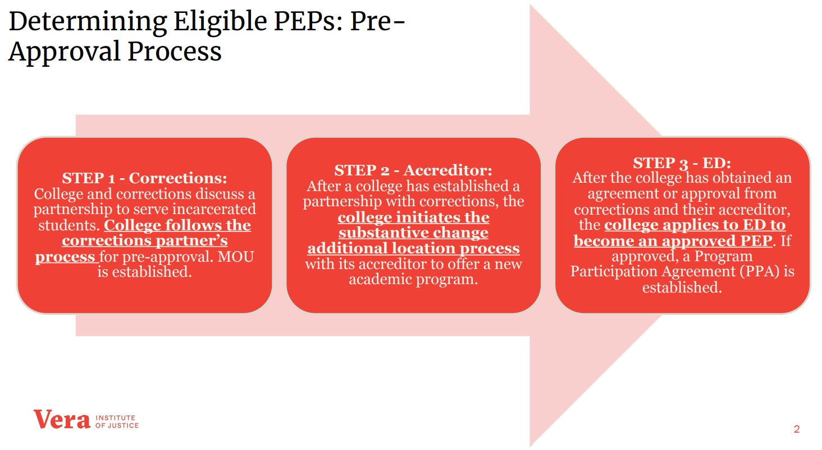
Getting Started

Slide 8
Getting Started
Institutions considering a PEP need to have wholehearted support from leadership and buy-in/support from all necessary departments.

Slide 9
PEP Positives
From the Community perspective
Reduction in recidivism
Saving tax dollars
Upward mobility
Workforce outcomes
Facility safety
Racial equity

Slide 10
PEP Positives
Institutional perspective
Increased enrollment
Faculty engaging in rewarding activities
Metrics improvement (increased completions, GPA, etc.)
Additional funding stream (shift as federal dollars return)

Slide 11
PEP Challenges
All processes are very manual, paper everything
Communication with the students is slow
Establishing a relationship/rapport with a Correctional Facility
Class/program offerings
Campus buy in
Students wanting to complete multiple degrees or programs and using most of Pell LEU

Slide 12
PEP Challenges
Defaulted loans
Obtaining financial information, especially from parents or spouses
SSN not matching name/DOB
Verification of Identity – use of prison ID is acceptable
Verification of high school completion – unofficial documents from the prison are acceptable

Slide 13
Presenter Discussion
Our programs and experiences educating inside the prison

Slide 14
Hope College
Hope-Western Prison Education Program
Partnership with Western Theological Seminary
Six-year renewable MOU with Muskegon Correctional Facility
2019 – Began offering non-credit courses
20 students at MCF
100% donor funded

Slide 15
Hope College
2021 – Launched Bachelor Degree-granting program, offering ONE academic major
2022 – Second cohort enrolled (12 students)
2023 – Currently admitting third cohort (20)
Expect a total of 80 students at any given time

Slide 16
Hope College
Applied for Second Chance Pell in 2019 & 2021
Passed the first phase both times
Did not receive an invitation to participate
Began preparing for Pell reinstatement in 2022
Received grant from JFF – Ready for Pell

Slide 17
Hope College
May, 2021 – received approval from State of Michigan (LARA) for additional location at MCF
October, 2021 – received approval from HLC for additional location at MCF
October, 2021 – received updated ECAR approving additional location at MCF
May, 2022 – received additional location confirmation from HLC following MCF site visit

Slide 18
Hope College
November/December, 2022 – worked with current students to submit the paper FAFSA
We have chosen not to submit electronically
ISIR's received in ~2 weeks
31 FAFSA's submitted
5 in default
2 Comment code 138
1 verification (V4)

Slide 19
Hope College
Two FA staff members working with HWPEP
FA staff will enter the prison for the first time in July for cohort 3 orientation
Program Co-Directors have been assisting with all financial aid processes to date

Slide 20
Hope College
Preparing for federal PEP application
Submitted application to MDOC to be reauthorized
Submitted comments - PEP Application NPRM
Awaiting final PEP Application to move forward

Slide 21
Jackson
Applied for Experimental Sites Initiative- Second Chance Pell (SCP) in 2015 or so
Approved for the program in summer of 2016
Began working within 6 facilities the first year (Parnall, Cooper, Cotton, Gus Harrison, Women’s Huron Valley, and Milan Federal)
Offered 4 associate degrees

Slide 22
Jackson
By the second year, increase to 8 total facilities (added Central Michigan and Lakeland)
First couple of years, enrollment hovered around 300-400 students
Then is spiked to 600-700 students and dropped again after COVID to 400 students
Currently, enrollment is approximately 550 students

Slide 23
Jackson
Originally, the Corrections Education Program office handled most of the work
Now, all of student services is involved including: Financial Aid, Advising, Student Resolution Advocate, and Records and Registration
We all enter the facilities during key times to assist the students. As well as have Jpay accounts to communicate with the students

Slide 24
Jackson
Financial Aid Responsibilities
Meet with large groups to collect FAFSAs and/or other required documents related to award processing
FAFSAs are brought to campus and entered by FA staff; turn around time is a few days
Enter facilities to speak to defaulted students about options for assistance (Fresh Start, Reconnect)
Send Jpay communications about FA Appeals, Fresh Start, Reconnect, or other issues

Slide 25
Jackson
Working through the kinks
Scheduling to align with Standard Term
Books and supplies…what is best?
Timing of processing FAFSA, aid, and class registration
Modality of instruction

Slide 26
Jackson
Graduation is provided to students in the facilities
President, Trustees, Corrections Education Program team, and other staff attend
Caps and gowns are provided
Facilities allow up to two family members to join in the ceremony

Slide 27
Resources
For an additional overview of the Prison Education Program requirements refer to DCL GEN-23-05 which covers 34 CFR 668.236, 34 CFR 668.237, 34 CFR 668.238, 34 CFR 668.241.
Review resources available in the Knowledge Center including the Prison Education Program Questions and Answers.
Review resources available in the FSA Partner Connect Topics page fsapartners.ed.gov/knowledge-center/topics/prison-education-programs
Contact the Vera Institute of Justice. They have been funded by the Department of Justice to provide technical assistance to colleges in prison programs.

Slide 28
Questions

