Slide 1
Financial Aid: How to Make Dreams Come True in Tough Times
Shariem Saterfield

Slide 2
Financial Aid: How to Make Dreams Come True in Tough Times
OBJECTIVES
The true nature of your value
How to build your departmental brand
How to strengthen your team
How to get the attention & support you need from the administration
Shariem Saterfield

Slide 3
The True Nature of your Value

Slide 4
DATA
85%
The percentage of students awarded some type of financial aid in 2021/2022
48%
The percentage of undergraduates in Michigan at 4-year institutions that receive loans.
The percentage of college costs covered by scholarships and grants in 2021-2022 according to survey.
26%

Slide 5
Your work makes dreams come true!
“Financial Assistance services are so important to our students in helping them achieve their goals,” said Alicea. “They were the people who were instrumental in getting me through my degree.
From a socio-economic perspective, it’s often the catalyst that allows the student to change their entire future earnings potential. This, by extension, improves the economic outlook of their family.”

Slide 6
Financial Aid: How to Make Dreams Come True in Tough Times
“You are very powerful, provided you know how powerful you are.” – Yogi Bhajan
Shariem Saterfield

Slide 7
Your Brand / Your Team/Your Impact

Slide 8
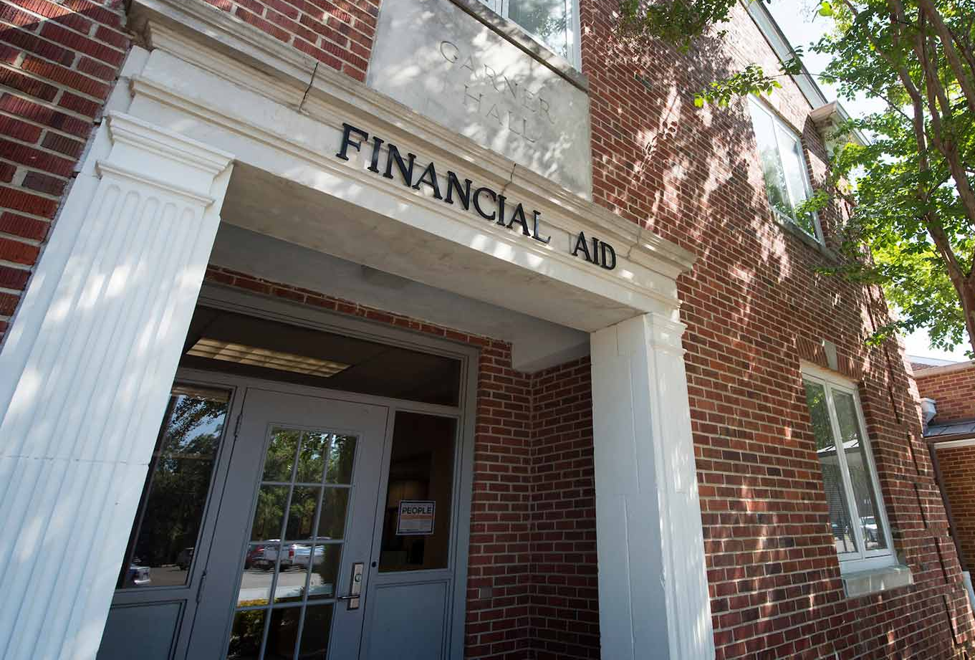
BRAND
Your brand is the reputation that your department has on and off campus.
The Financial Aid Department is……….
(What are the misperceptions that hurt your department?)

Slide 9
Financial Aid: How to Make Dreams Come True in Tough Times
Financial Aid Services
The Misperceptions
The Financial Aid Dept.
The
The Fun Stoppers
The Paperwork Police
Captains of Complexity

Slide 10
Financial Aid: How to Make Dreams Come True in Tough Times
Financial Aid Services
The Reality
The Pathfinders
The Dream Makers
Dept.
Aid
The Scholarship Saviors
Financial
The
The Fairy Godparents of Funding

Slide 11
Department Brand Analysis
1
2
3
What is the current state of your brand?
What is the impact of your current brand?
What are your goals and aspirations?
What are you known for now?
How does that make you feel?
Take a poll of students, faculty, and staff.
How is your department treated?
How hard so you fight for support and resources?
What are you included in and excluded from?
What do you want to accomplish/achieve?
What do you want to be known for?
What kind of impact do you want to have?

Slide 12
Financial Aid: How to Make Dreams Come True in Tough Times
How can you change the opinions and misperceptions about your department?
?
Shariem Saterfield
Notes:
Now that we have reminded everyone of how critical you are to the students, to the university and to

Slide 13
Financial Aid: How to Make Dreams Come True in Tough Times
Brand
SELF DIAGNOSIS
How do you Show Up?
How do you Act?
How do you Communicate?
Website
Offices
Flyers
Team Culture
Customer Service
Communication
Processing
Students
Community
Other Departments
Stakeholders
Shariem Saterfield

Slide 14
Financial Aid: How to Make Dreams Come True in Tough Times
INNOVATION
Shariem Saterfield

Slide 15
RESOURCES
$
Current Students
Greek Letter Organizations
Business Groups
Other Departments
MSFAA
NASFAA
Professional Groups
Other College Fin Aid Departments
Alumni
Parents
Politicians
Community Groups
External
Internal
Industry
Shariem Saterfield

Slide 16
BRAINSTORMING
Deferral
Community
Scholarship
Student
Videos
Partnerships
Politician
Activities
Fairs
Programs
Podcasts
Alumni
Loan Management
Financial Literacy
Seminars
Webinars
MSFAA
Stakeholder
Associations
Games
Ambassadorships
Extra Credit
Peer to Peer
Parent
Apps
FAFSA
Loan
Business Group

Slide 17
IDEAS
Deferral
Community
Scholarship
Partnerships
Student
Videos
Politician
Activities
Fairs
FAFSA APP Challenge
Programs
Podcasts
Alumni
Student Ambassadors Program
Loan Management
Alumni Loan Management Podcast
Financial Literacy
MSFAA Stakeholder Webinars
Seminars
Webinars
Scholarship Scavenger Hunt
MSFAA
Stakeholder
Associations
Games
Ambassadorships
Extra Credit
Peer to Peer
Parent
Apps
FAFSA
Loan
Business Group

Slide 18
INTERNAL DEVELOPMENT
Document Team Challenges
Document Individual Challenges
Discuss Individual strengths
Establish Team Goals and Processes
Focus on Team Mental Health
Create a Team Innovation & Communication Plan

Slide 19
Gold Star Winners
University of Illinois Urbana-Champaign: Special Circumstances - Helping Families Help Themselves
University of South Florida : A Peer-Based Financial Badging Program
UC Santa Barbara: "Seven Easy Steps to the FAFSA: A Student's Guide
Southern Association of Student Financial Aid Administrators (SASFAA) : State President's Guidebook.
Honorable Mention:
Michigan Association of Student Financial Aid Administrators - "Michigan Legislative Training and Capitol Visits"

Slide 20
SUPPORT GENERATION
Network more
Take action before asking
Use language “they” understand
Find workarounds
Team Up
Ask Others

Slide 22
DREAM MAKERS
Don’t ever forget what you are…

Slide 23
Shariem Saterfield, MBA, CPTM
About Me
Certified Professional in Training Management
20 Years in training & development
Leadership, DEIB Training & Team Cohesion Development
University of Miami, FL Alum (Go Canes!)
www.saterfieldconsulting.com

