Slide 1
How FA Offices can better serve our students of color.
Reflecting on the Past, Celebrating the Present, Shaping our future together.
2023 Conference

Slide 2
Moderator:
Michael Jones. Vice President, Citizens
Panelists:
Shashanta James. Director of Financial Aid, Western Michigan University
Kemmoree Duncombe. Director of Financial Aid, Kirtland Community College
LaJanis Allen. Director of Compliance and Student Services, Douglas J. Aveda Institute
Andrew Zerkel. Assistant Director, Training and Compliance, Eastern Michigan University

Slide 3
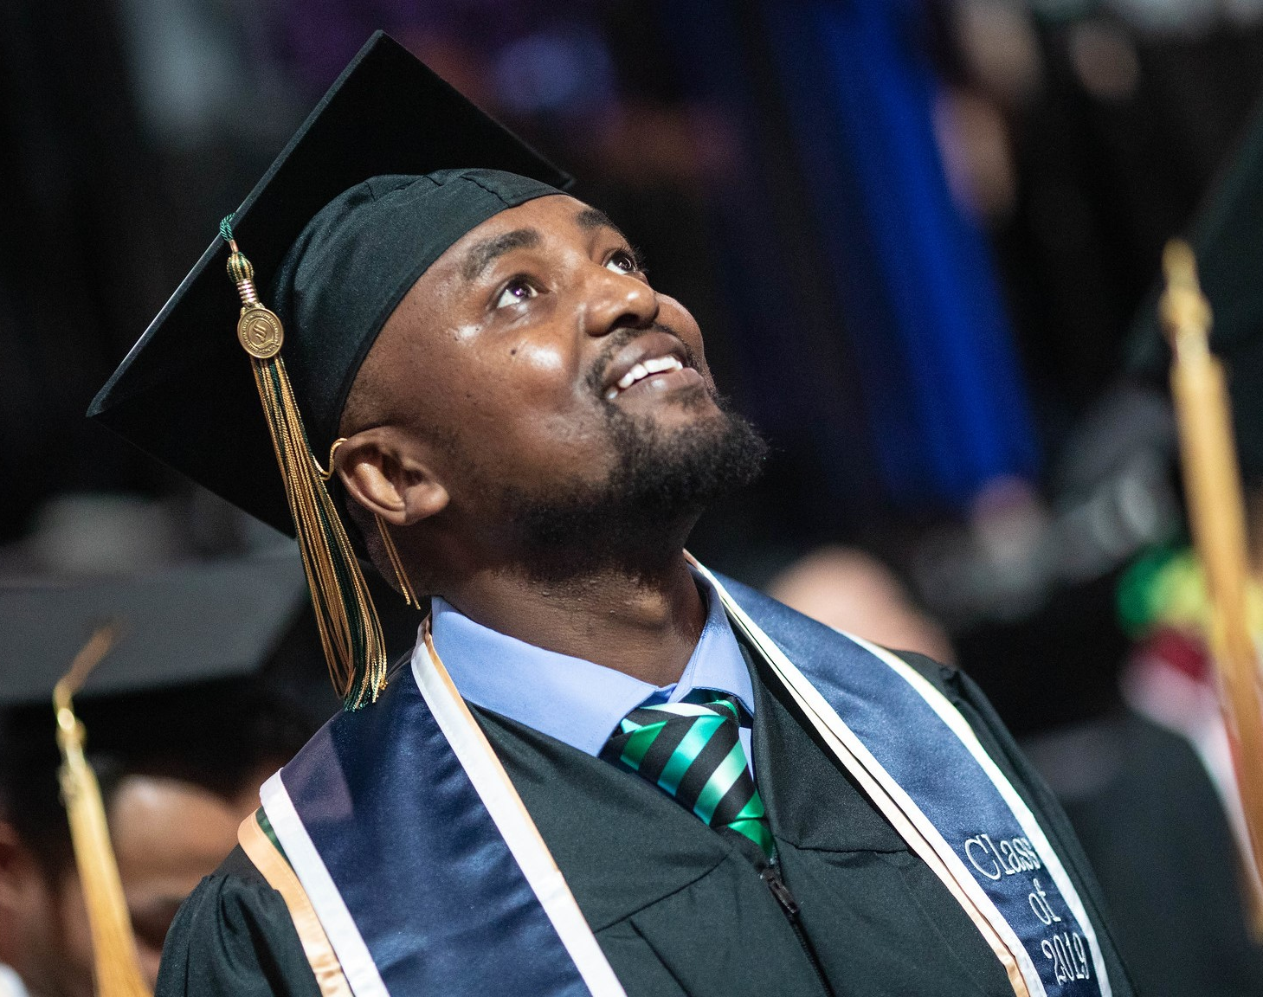
Purpose of Session
This session will focus on ways Financial Aid Offices can work to remove institutional and systemic barriers for students of color. The panel will share their lived experiences and discuss ways to enable our students of color opportunities to be successful and reach their academic goals.

Slide 4
Question 1
What role does RESPECT play when working with our students regardless of their identities?

Slide 5
Question 2
How do assumptions block us from seeing the whole student?

Slide 6
Question 3
What barriers do our offices encounter that keep them from succeeding?

Slide 7
Question 4
What role do our offices/colleges play in creating barriers for students?

Slide 8
Question 5
How can you be a change-maker on your campus?

Slide 9
Question 6
What resources are available on our campuses/within MSFAA or NASFAA to provide professional development to our staff?

Slide 10
Helpful Resources
NASFAA Implicit Bias Toolkit
https://www.nasfaa.org/implicit_bias_toolkit
NASFAA Removing Barriers/Expanding Opportunity https://www.nasfaa.org/uploads/documents/NASFAA_HEA_Reauthorization_Priorities_Brief.pdf
Southern Poverty Law Center
https://www.splcenter.org/
The Hope Center: Temple University
https://hope.temple.edu/
Color of Change
www.ColorOfChange.org

Slide 11
Helpful Resources
National Association for the Advancement of Colored People
www.naacp.org
National Civil Rights Museum
www.civilrightsmuseum.org
Question Bridge (Questions by and about Black Men)
www.questionbridge.com
Black Youth Project
www.blackyouthproject.com

Slide 12
QUESTIONS

Slide 13
Additional Questions to Ponder
How important is it to acknowledge our own biases when working with the various stakeholders (be they internal or external/students or staff).
How can we manage expectations so that our students feel empowered when making decisions?
Are there steps you recommend to help your staff remove the barriers students encounter?

