Slide 1
MI STUDENT AID PRESENTS:
MAKING COLLEGE
ACCESSIBLE, AFFORDABLE, ATTAINABLE

Slide 2
NEW STATE PROGRAMS & THEN SOME!
DIANN COSME & JENNIFER MAURER

Slide 3
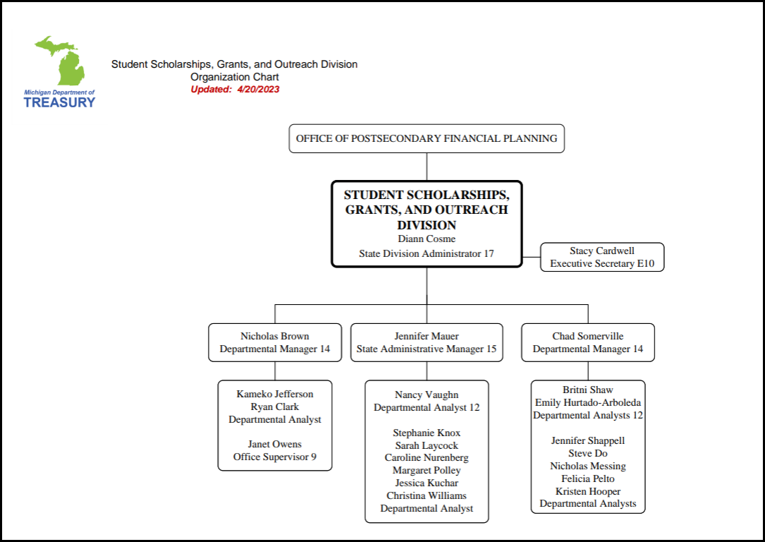
STUDENT SCHOLARSHIPS,
GRANTS AND OUTREACH
Not Listed
Customer Care Center (9)
Student Assistants (2)
Departmental Specialist (1)
Notes:
https://www.michigan.gov/mde/services/ed-serv/educator-recruitment/future-proudmieducator/individuals-working-in-pk12-schools/staff-grant

Slide 4
STATE FINANCIAL
AID PROGRAMS

Slide 5
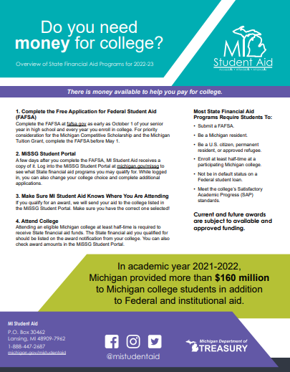
STATE FINANCIAL AID
PROGRAMS
Children of Veterans Tuition Grant (CVTG)
Dual Enrollment (DE)
Fostering Futures Scholarship (FFS)
Futures for Frontliners/Path 2 (F4F)
MI Future Educator Fellowship
MI Future Educator Stipend
MI GEAR UP Scholarship (MI GEAR UP)
Michigan Achievement Scholarship/Skills
Michigan Competitive Scholarship (MCS)
Michigan Reconnect Scholarship/Skills
Michigan Tuition Grant (MTG)
Police Officer’s and Fire Fighter’s Tuition Grant (STG)
Michigan Achievement Scholarship
Tuition Incentive Program (TIP)

Slide 6
STATE FINANCIAL AID
PROGRAMS
Program | FY21 | FY22 | FY23
Children of Veterans Tuition Grant and Police Officer’s and Fire Fighter’s Survivor Tuition Grant | $1,400,000 | $1,400,000 | $1,400,000
Dual Enrollment Program | $2,332,600 | $3,000,000 | $3,000,000
Fostering Futures Scholarship | $750,000 | $750,000 | $750,000
Futures for Frontliners Scholarship/Path II | $24,000,000 | FY21 carry forward + $25,000,000 | FY22 carry forward
MI GEAR UP | $3,200,000 | $3,200,000 | $3,200,000
MI Future Educator Fellowship | - | - | $25,000,000
MI Future Educator Stipend | - | - | $50,000,000
Michigan Achievement Scholarship/Skills | - | - | $250,000,000
Michigan Competitive Scholarship | $29,861,700 | $29,861,700 | $29,861,700
Michigan Tuition Grant | $42,021,500 | $42,021,500 | $42,021,500
Michigan Reconnect Scholarship | $22,000,000 | FY21 carry forward +$40,000,000 | FY 22 carry forward + $40,000,000
Tuition Incentive Program | $68,800,000 | $71,300,000 | $71,300,000
TOTALS | $194,365,800 | $220,933,200 | $517,933,200

Slide 7
MI FUTURE
EDUCATOR PROGRAMS

Slide 8
MI FUTURE EDUCATOR
FELLOWSHIP
A new $10,000 scholarship program to create low-cost tuition pathways for future Michigan educators every year.
Annual application is required and opens in May each year
Up to $10,000
As of May 15, 2023:
3,445 applications received
611 students awarded
$4.9 million paid

Slide 9
MI FUTURE EDUCATOR
FELLOWSHIP - Process Flow
Step 1: Application – Completed by the Student
Step 2: Eligibility – Completed by the Michigan Department of Treasury
Step 3: Verification – Completed by the Institution
Step 4: Confirmation – Completed by the Student
Step 5: Commitment – Completed by the Student
Step 6: Reimbursement – Completed by the Institution
Step 7: Payment – Completed by the Michigan Department of Treasury
Step 8: Disbursement – Completed by the Institution
Notes:
Student applies for the MI Future Educator Fellowship in the MiSSG Student Portal.
Student is evaluated as ‘Eligible’ or ‘Ineligible’ based on their responses to the application questions.
‘Eligible’ students are identified in MiSSG for the institution to confirm the students meet the additional eligibility criteria.
Students who are confirmed as eligible by the institution will be issued a Commitment to Teach in Michigan Agreement via email, for electronic signature.
Students who are confirmed as eligible by the institution will be issued a Commitment to Teach in Michigan Agreement via email, for electronic signature.
Students who sign the Commitment to Teach in Michigan Agreement will be identified in MiSSG for the institution to request a reimbursement.
The institution completes reimbursement request for tuition and required fees for each eligible student, up to a maximum of $10,000 per academic year.
Michigan Department of Treasury issues payments to the institution, as requested on the reimbursement.
The institution disburses payment to students and applies payment to their student account.

Slide 10
MI FUTURE EDUCATOR
STIPEND
A $9,600 stipend per semester to support Michigan’s hardworking student teachers as they continue their journey to being in the classroom full-time.
Annual application is required and opens in May each year
Up to $9,600 per semester
As of May 15, 2023:
3,158 applications received
2,277 students awarded
$24.3 million paid

Slide 11
MI FUTURE EDUCATOR
STIPEND
Step 1: Application – Completed by Student
Step 2: Eligibility – Completed by Michigan Department of Treasury
Step 3: Verification – Completed by Higher Education Institution
Step 4: Certification – Completed by the Higher Education Institution
Step 5: Payment – Completed by the Michigan Department of Treasury
Public Institution Payments
Michigan Department of Treasury issues payments for students who attend the public institution to the public institution as requested on the certification. The public institution disburses the payment directly to the student teacher.
Private Institution Payments
Michigan Department of Treasury issues payments for students who attend the private institution to the school district where the student is completing their student teaching. The school district must agree to pass this payment onto the student teacher’s institution and the institution disburses the payment directly to the student teacher.
Notes:
Student applies for the MI Future Educator Stipend in the MiSSG Student Portal.
Student is evaluated as ‘Eligible-pending Stipend Verification Form’ or ‘Ineligible’ based on their responses to the application questions.
If eligible, student is presented with a MI Future Educator Stipend Verification Form in the MiSSG Student Portal.
The institution certifies awards based on eligibility requirements up to $9,600.
Michigan Department of Treasury issues payments to the Public Institution or the Private Institution.

Slide 12
MICHIGAN ACHIEVEMENT
SCHOLARSHIP

Slide 13
MICHIGAN ACHIEVEMENT
SCHOLARSHIP
Provides renewable scholarships for undergraduate students who graduate from high school in Michigan with a diploma, certificate of completion, or achieved a high school equivalency certificate in 2023 or after.
Students must be attending an eligible Michigan postsecondary institution.
Students must demonstrate financial need when they complete the Free Application for Federal Student Aid (FAFSA) by having an Expected Family Contribution (EFC) of $25,000 or less.
No special application, just FAFSA
Award Amount Varies

Slide 14
MICHIGAN ACHIEVEMENT
SCHOLARSHIP
Up to $2,750 if they attend a community college, per year, up to 3 years
Up to $4,000 if they attend a private college or university, per year, up to 5 years
Up to $5,500 if they attend a public university, per year, up to 5 years
Resources
Michigan.gov/Achievement
Fact Sheet
Packaging Order Guidance
Frequently Asked Questions
Digital Toolkit
Flyer Available in Spanish

Slide 15
MICHIGAN ACHIEVEMENT
SKILLS SCHOLARSHIP
What is it? For students seeking to enroll in an eligible career training program - perhaps in lieu of or before participating in the Michigan Achievement Scholarship.
Students who qualify for this scholarship will be eligible for:
Up to $2,000 towards tuition costs if they attend an eligible career training program, per year, up to two years.
Students cannot be awarded both a Michigan Achievement Scholarship and Michigan Achievement Skills Scholarship in the same academic year.
Michigan Achievement Skills Scholarship participants can still receive a Michigan Achievement Scholarship for the maximum 5 years, less any years spent participating in the Skills Scholarship.
Notes:
First, to help differentiate between the two pathways, the Skills Scholarship is specifically for eligible students who are seeking to enroll in a eligible career training program.
Students can choose to participate in the Skills Scholarship either in lieu of or before participating in the Michigan Achievement Scholarship. Students cannot participate in both pathways in the same academic year. However, once they complete a certification in their course of study with the Skills Scholarship, they can go on to participate in the Michigan Achievement Scholarship if they still qualify. Any time spent participating in the Skills Scholarship will just go against the overall five-year time limit
Students who participate in the Skills Scholarship can qualify for up to $2,000 toward tuition costs per year, for up to two years. So, the total maximum they could receive would be $4,000.
NEXT

Slide 16
MICHIGAN ACHIEVEMENT
SKILLS SCHOLARSHIP
Complete a Skills Scholarship application (Available August/September)
Be a Michigan resident for at least a year
Graduate from a Michigan high school (or its equivalent) in 2023 or after.
Not have previously earned an associate or bachelor’s degree
Eligible students can continue to participate in the Skills Scholarship until they earn a degree, certificate, or other credential with this Skills Scholarship or until two academic years have passed since they began participating – whichever comes first.
Notes:
First, to help differentiate between the two pathways, the Skills Scholarship is specifically for eligible students who are seeking to enroll in a eligible career training program.
To be eligible for this pathway,
- Students will be required to complete a Skills Scholarship application which will be available August/September
They will need to be a Michigan resident for at least year
They will need to have graduated with a high school diploma, certificate of completion or high school equivalency in 2023 or after
Not have previously earned an associate or bachelor’s degree
Students can continue to participate in the Skills Scholarship until they earn a degree, certificate or other credential under this scholarship or until two academic years have passed since they began participating – whichever comes first.
NEXT

Slide 17
REMINDERS FOR
ACADEMIC YEAR 2022-23

Slide 18
2022-23
REMINDERS
Q3 Payment for Reconnect and F4F June 30, 2023
Q4 Payment August 16, 2023
Year-end Balancing
Refunds to SSGO due September 16, 2023
Beginning Summer 2023, no longer requiring half-time enrollment for F4F/Reconnect
Annual Compliance Report due to LEO June 30, 2023

Slide 19
UPDATES FOR
ACADEMIC YEAR 2023-24

Slide 20
2023-24
UPDATES
MCS & MTG Calculation of Award
Removed Factored Expected Family Contribution
TIP Fee Maximum Increase
$450 per semester
Mandatory Fees Redefined for All Programs
“mandatory fees must be fees specified in the institution’s course catalog as a condition of enrollment and/or required for the student’s completion of an eligible certificate or degree (such as online fees and lab fees required for course enrollment).”
MI Future Educator Stipend Verification Workflow

Slide 21
2023-24
LEO UPDATES
Students will no longer be required to be enrolled at half-time minimally
Colleges will begin evaluating students for renewal based on SAP or 2.0 scholarship GPA
Colleges will begin evaluating students for renewal based on earning a minimum of 12 credits instead of continuous enrollment
Colleges will have flexibility in applying the scholarship if the student is out-of-district (i.e., Reconnect/F4F will no longer stop the school from applying their Pell to their out-of-district costs too)
Colleges can request reimbursement for $80 per credit hour for credit for prior learning
Institution must provide student with development education in a co-requisite model only if they need remedial education.

Slide 22
MiSSG

Slide 23
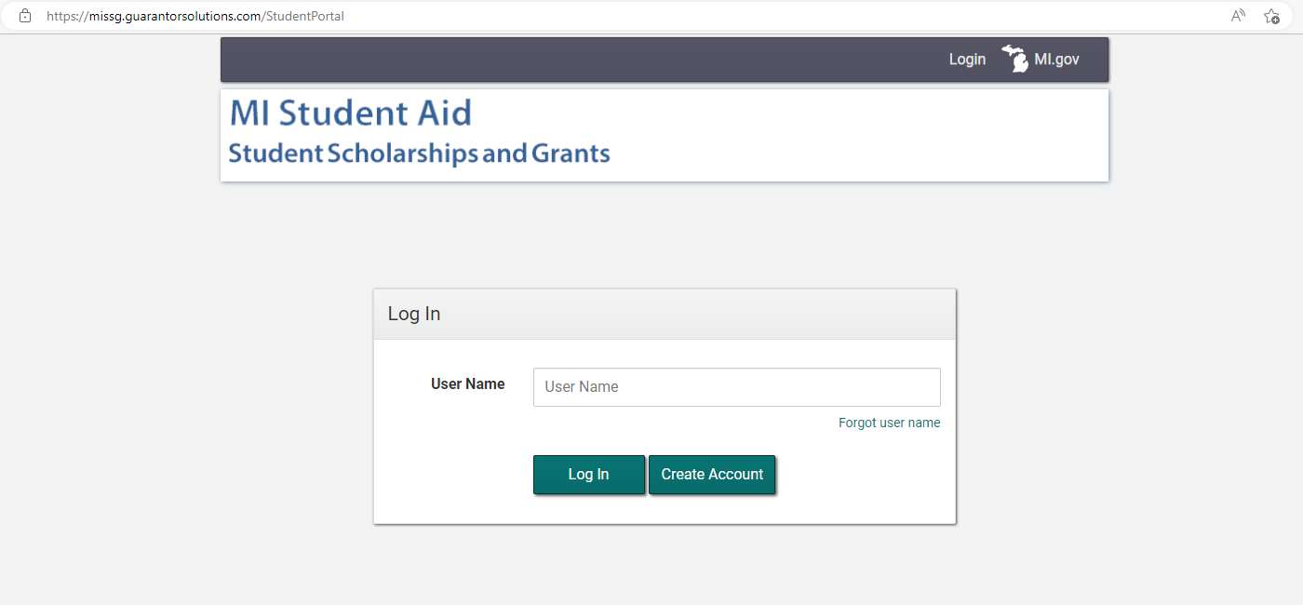
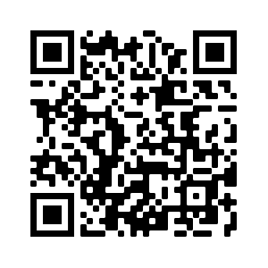
MiSSG
STUDENT PORTAL
Enhancements Coming to Improve User Experience

Slide 24
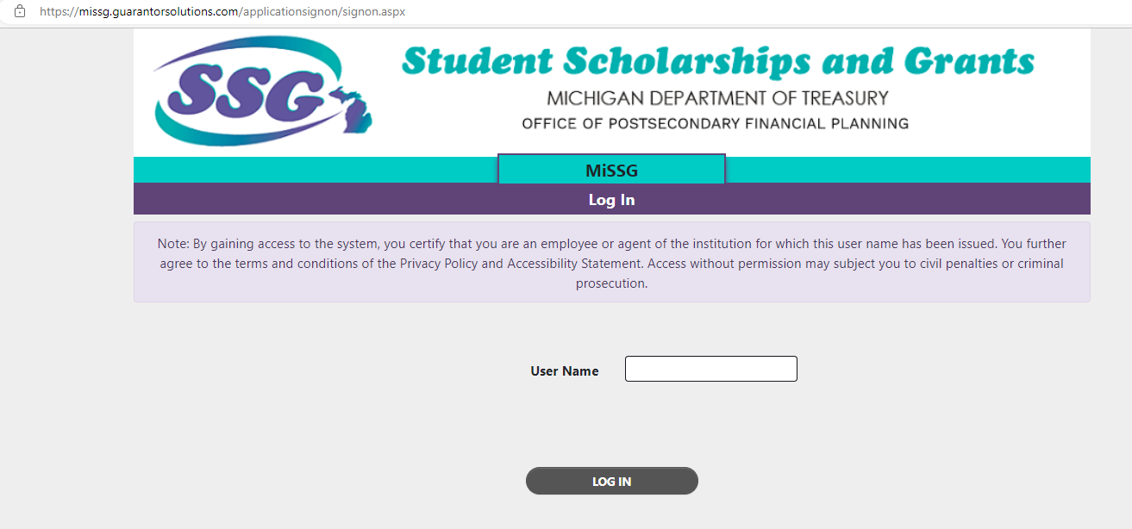
MiSSG
COLLEGE AID ADMIN PORTAL
2023-24 College Security Access Forms Available in June.
MiSSG File Formats
MiSSG Manual

Slide 25
MI STUDENT AID
SERVICES

Slide 26
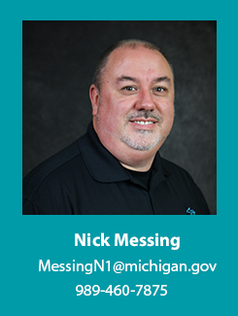
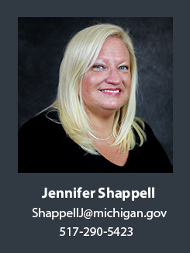
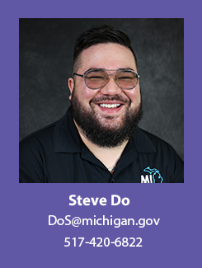
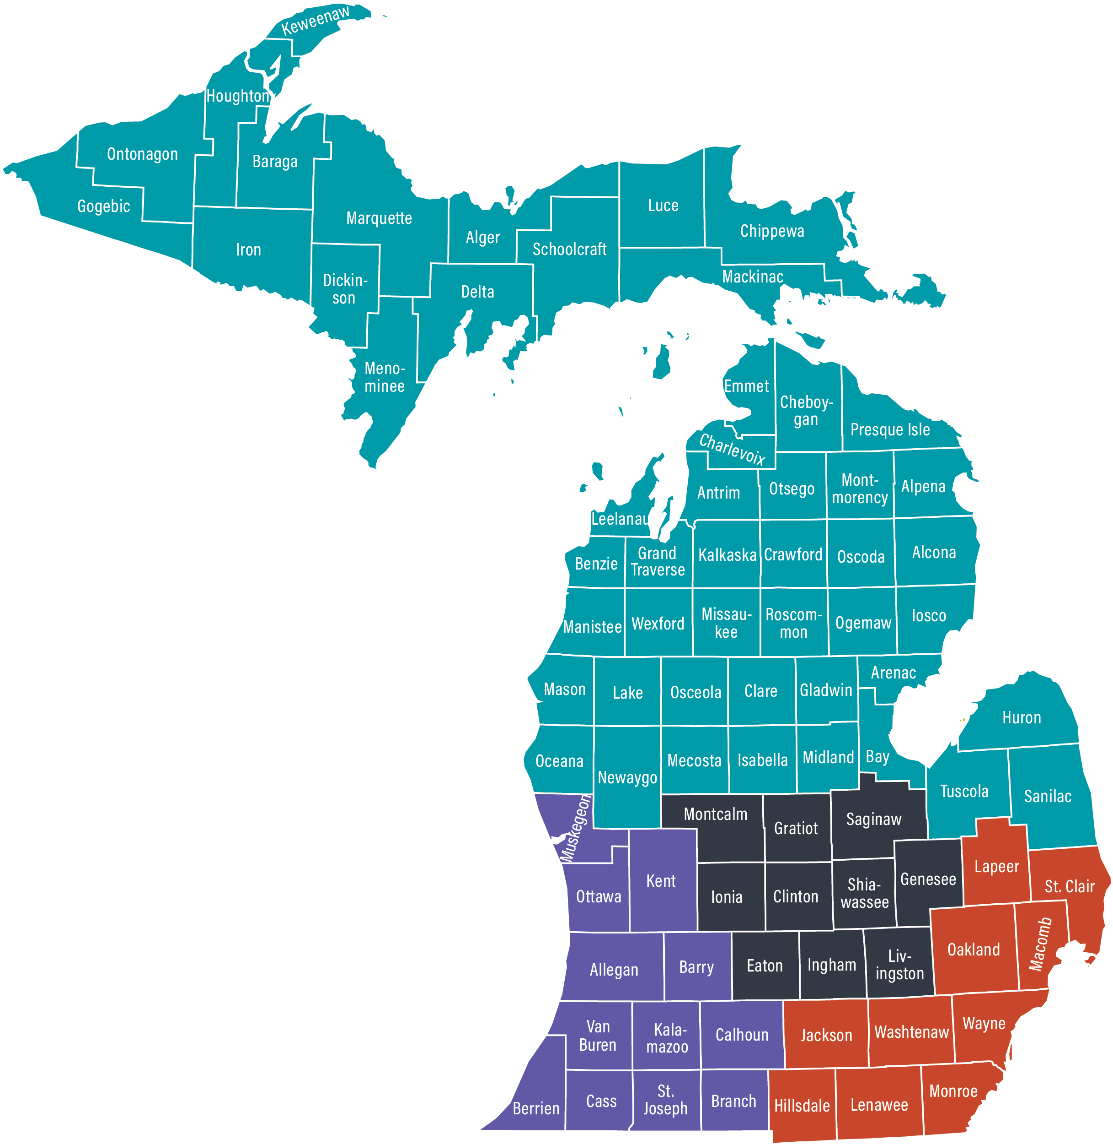
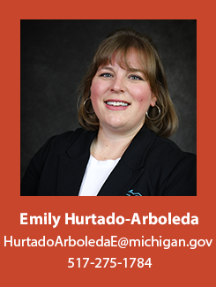
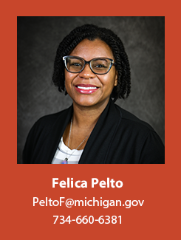
Four Regions, One State

Slide 27
MI STUDENT AID
OUTREACH EVENTS
Financial Aid 101
Financial Aid Jeopardy
Financial Reality
Michigan Achievement Scholarship for Students and Families
TIP Talk
Understanding Your Award Letter
MiSSG/Financial Aid Training for Counselors

Slide 28
Questions?

