Slide 1
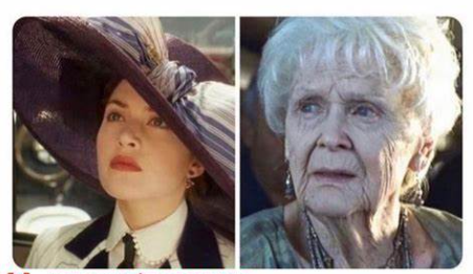
Welcome 2-Year Public Sector!
Reflecting on the Past, Celebrating the Present, Shaping our future together.
2023 Conference
What a year it has been!
MSFAA Conf 2022 MSFAA Conf 2023

Slide 2
Topics - how are you handling…
Michigan Reconnect & Frontliners Changes
Michigan Achievement Scholarship Implementation
New State of MI mandatory Fee definition
COA disclosures on tuition web pages/printed materials

Slide 3
Michigan Reconnect/F4F Changes
Transition from Continuous Enrollment & 2.0 to SAP or 2.0
<6 credit enrollment
12 credits earned per academic year

Slide 4
Michigan Achievement Scholarship Implementation
Awarding group
Last dollar awards
High school completion

Slide 5
New State of MI Mandatory Fee Definition
All fees charged to all students upon registration for a course
Challenges w/general category of course fees?

Slide 6
COA component disclosures
Tuition web pages - how much detail? NPC?
Printed materials

Slide 7
Welcome our 2023-24 Sector Rep!
Janette Schocke
Mott Community College
(810) 762-0144
janette.schocke@mcc.edu

