Slide 1
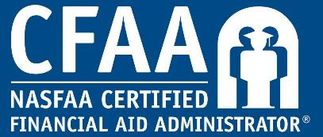
Certification Insights: NASFAA’s Certified Financial Aid Administrator® Program
Reflecting on the Past, Celebrating the Present, Shaping our future together.
2023 Conference

Slide 2
Craig Alan Slaughter, FAAC®
Associate Vice President for Enrollment, Director of Financial Aid, Kenyon College
President, MASFAA www.masfaaweb.org
Chair-Elect, CFAA Commission
www.nasfaa.org/certification_commission
Notes:
Introductions Good afternoon. My name is Craig Slaughter, I’m associate vice president for enrollment and director of financial aid for Kenyon College. A small private college in central Ohio.
You’ll notice after my name it references that I am an FAAC, but you’ll notice that the Program called CFAA.
Just curious who knows the difference between the two and why there is a difference?
The “Financial Aid Administrator – Certified” or FAAC® designation is awarded through NASFAA’s Certified Financial Aid Administrator® Program
And affirms that individuals who hold this designation possess foundational knowledge necessary to effectively administer Title IV federal student aid programs at colleges and universities across the country as a financial aid professional.
Certified Forensic Accounting Analyst - CFAA
I sat for my credential exam in May 2019 so I have been an FAAC for four years.

Slide 3
Agenda
Welcome
Community Built, Community Driven
Get Started Today!
Eligibility
Preparing For Your Exam
Your Exam Experience
Maintain Your Certification
Invest In Your Future
Questions
Notes:
Agenda
Here’s our plan for today. I’ll take questions along the way and again at the end.

Slide 4
Poll Question
What phase of the certification process are you in?
I haven’t applied yet, but I’m interested in learning more
I’ve applied, but I haven’t purchased my knowledge exam yet
I’ve purchased my knowledge exam
I’m an FAAC®!

Slide 5
Setting the Standard
“As an FAAC, you’ve demonstrated the courage to assess your knowledge and the tenacity to develop as a financial aid professional. Together, as a community, we raise the esteem of our profession and, in turn, support each other in fulfilling our commitment to students and to our nation.”
Christina Tangalakis, FAAC®
Commission Chair, 2022-23
Notes:
Setting the Standard
The CFAA Program benefits you as an individual AND the financial aid profession by setting the standard for what it means to be qualified to administer the federal financial aid programs.
The foundation for the CFAA Program is built upon three principles. Knowledge, Experience and Integrity.
You will combine the knowledge and experience you’ve gained as a financial aid administrator to show what you know on the knowledge exam. You will also affirm your integrity and your continued commitment to ethical behavior.
The mission of this certification is to enhance the future of the financial aid community by inspiring quality job performance, encouraging continuous learning, and promoting professional development among financial aid administrators.

Slide 6
Community Built
Purpose: enhance the future of the financial aid profession
Recognize knowledge and experience
Inspire quality job performance and ethical behavior
Encourage continuous learning and professional growth
Spring 2018
Fall 2018
January 2019
May 2019
June 2019
April 2021
August 2021
January 2022
February 2022
Board Approval
Job Task Analysis
Item Writing Workshop
Beta Test & Item Analysis
Launch at National Conference
Accreditation
Slack Community Launched
Recertification & First 100+ Club Members
First FAAC Forum
Notes:
­­­Community Built
This program was built by the community. It was created with the help of financial aid administrators from different types of colleges and universities across the country who represented the entire financial aid community. These volunteers served as subject matter experts, and volunteers continue to be a vital part of this program. They help sustain the program through regular review and periodic updates, to help keep up with regulatory changes.
As you can see, developing and implementing the certification was a long process, but it was worth it. In April 2021, which is less than two years after its launch, NASFAA's Certified Financial Aid Administrator® Program became accredited. The CFAA Program met the qualifications of the Credentialing Quality Standards (CQS) of accreditation, both in operations and psychometrics. This accreditation addresses the quality and defensibility of certification programs. The successful outcome of this accreditation process is a testimony to the work and dedication of the financial aid professionals who contribute to the development and ongoing maintenance of this program.
Since then, the Slack Community was launched to support the FAAC community and provide a networking resource. Early in 2022, the first of our FAACs recertified, and we welcomed our first-ever 100+ Club members! And in February 2022, the first-ever FAAC Forum convened in Washington DC as its own specialized track of the NASFAA Leadership Conference & Expo. After the success of the initial Forum, we planned and held the second FAAC Forum in February 2023. We plan to continue hosting the FAAC Forum for learning, networking, and community building every two years.

Slide 7
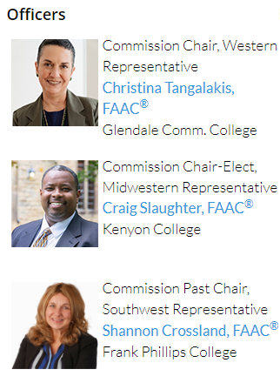
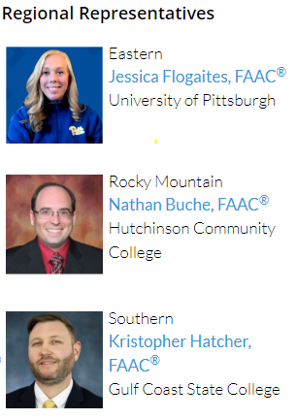
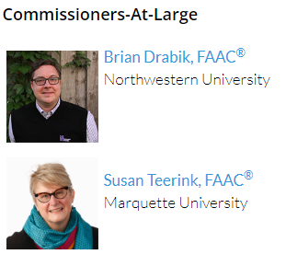
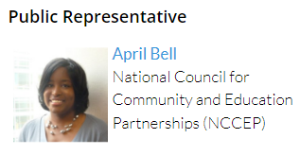
Community Driven
Notes:
Community Driven
The CFAA Program Commission convened for the first time in January of 2019. Limited terms of service help ensure new representation every year, beginning each July 1.
You may see some familiar faces on this slide, including MASFAA members Brian Drabik and Susan Teerink. My role as chair elect of the FAAC program begin in July and I will assume leadership of the commission on July 1, 2023.
Commissioners contribute to the direction of the CFAA Program, oversee the integrity of the program, and consistently seek out feedback from the financial aid community to help guide the program. So I encourage you to provide me with feedback or any of the commissioners to help us continue to be get better.

Slide 8
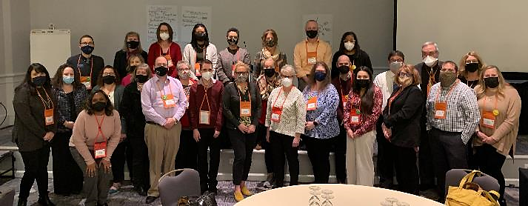
Community Engagement
Connect with your peers via the FAAC Slack Channel
Join webinars and events for FAACs
Participate in the FAAC Forum
Be recognized at conferences
Gain access to NASFAA Leadership
Learn, grow, and find mentors within the financial aid profession
Notes:
Community Engagement
We’ve mentioned community a few times already and want to highlight some of the ways FAACs are getting involved.
FAACs are invited to join a slack channel, which is a private instant messaging service. This provides FAACs immediate access to a wealth of knowledge and experience. FAACs share personal and professional information within the channel.
The FAAC Forum is a track of the Leadership Conference that is significantly discounted. It provides FAACs an opportunity to connect face to face.
Webinars and exclusive events offer FAACs the chance to learn directly from top leaders in our field.
The FAAC designation comes with a multitude of opportunities for networking, peer-to-peer connections, and professional growth.
QUESTION: Has anyone been involved yet with the FAAC Community?

Slide 9
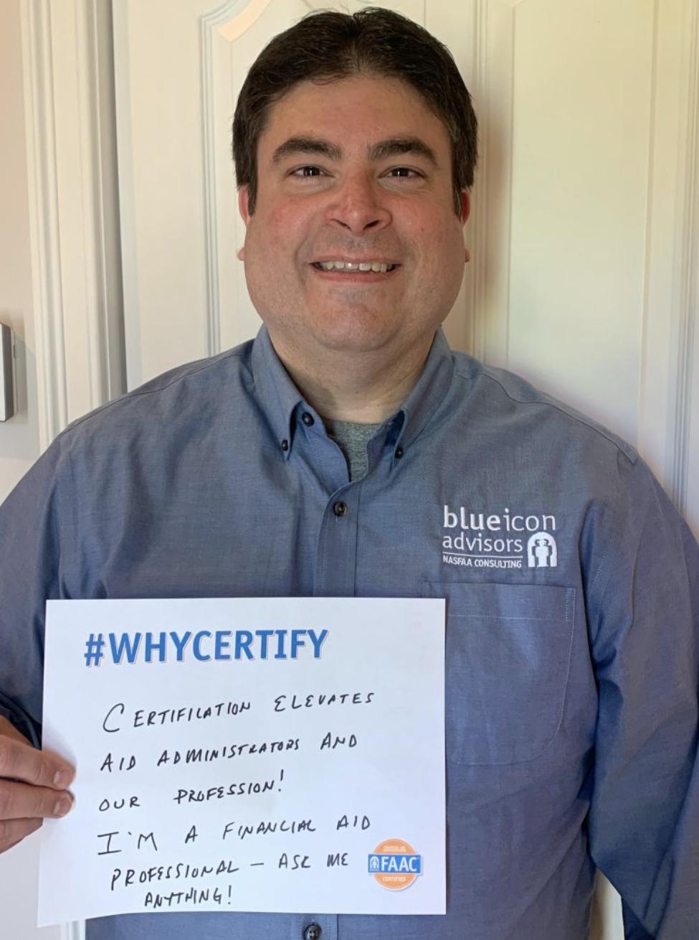
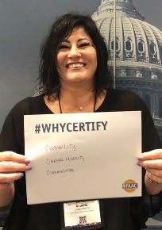
Benefits for FAACs
#WhyCertify nasfaa.org/whycertify
Notes:
Benefits for FAACs
The national association (NASFAA) receives feedback from FAACs regularly, and we love to hear how they have benefited from the FAAC designation. If you’re already an FAAC, you can share your reasons for certification on your social media feed using the hashtag #whycertify Find templates online at https://www.nasfaa.org/whycertify
The most commonly shared benefits include:
More credibility across campus
Increased confidence in their own knowledge
New opportunities to lead at the state and regional level
Being part of a strong community of peers
Ability to negotiate a higher compensation package
Increased career mobility
Question – How have you benefitted from certification?

Slide 10
Get Started Today
CHECK YOUR ELIGIBILITY
APPLY ONLINE
PASS THE EXAM
MAINTAIN YOUR CERTIFICATION
Notes:
Get Started Today
To earn the recognition you deserve, the initial process is straightforward:
First, check to make sure you meet the qualifying criteria, established by the Commission.
Once you’ve confirmed you’re eligible, you’ll apply online and get ready to sit for the knowledge exam.
Then you’ll need to take and pass the exam!
Fortunately, you’ll only have to take the exam once. You can maintain the FAAC designation without taking the exam again, as long as you keep up with the recertification requirements and don’t let your FAAC designation expire.

Slide 11
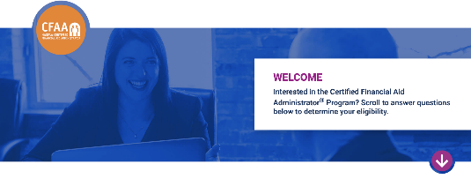
Check Your Eligibility
Professional financial aid experience and knowledge:
5 years or more;
3 years with at least 7 NASFAA credentials; or
1 year with at least 12 NASFAA credentials
Hold a bachelor’s degree or higher OR at least 10 years of financial aid work experience
Attest to uphold NASFAA’s Code of Conduct and Statement of Ethical Principles
nasfaa.org/certification_interactive
Notes:
Check Your Eligibility
To qualify to sit for the certification knowledge exam, you do need to meet the qualifying criteria outlined on the screen.
There is an interactive tool to check whether you meet the eligibility requirements. The tool is free and completely anonymous and requires no commitment. It’s available to both members and non-members, which is important to note. You don’t have to be a NASFAA member to become an FAAC.
If you don’t meet an eligibility requirement, the tool will provide feedback on what you need to do to qualify, such as gaining more years of experience or earning more professional credentials.

Slide 12
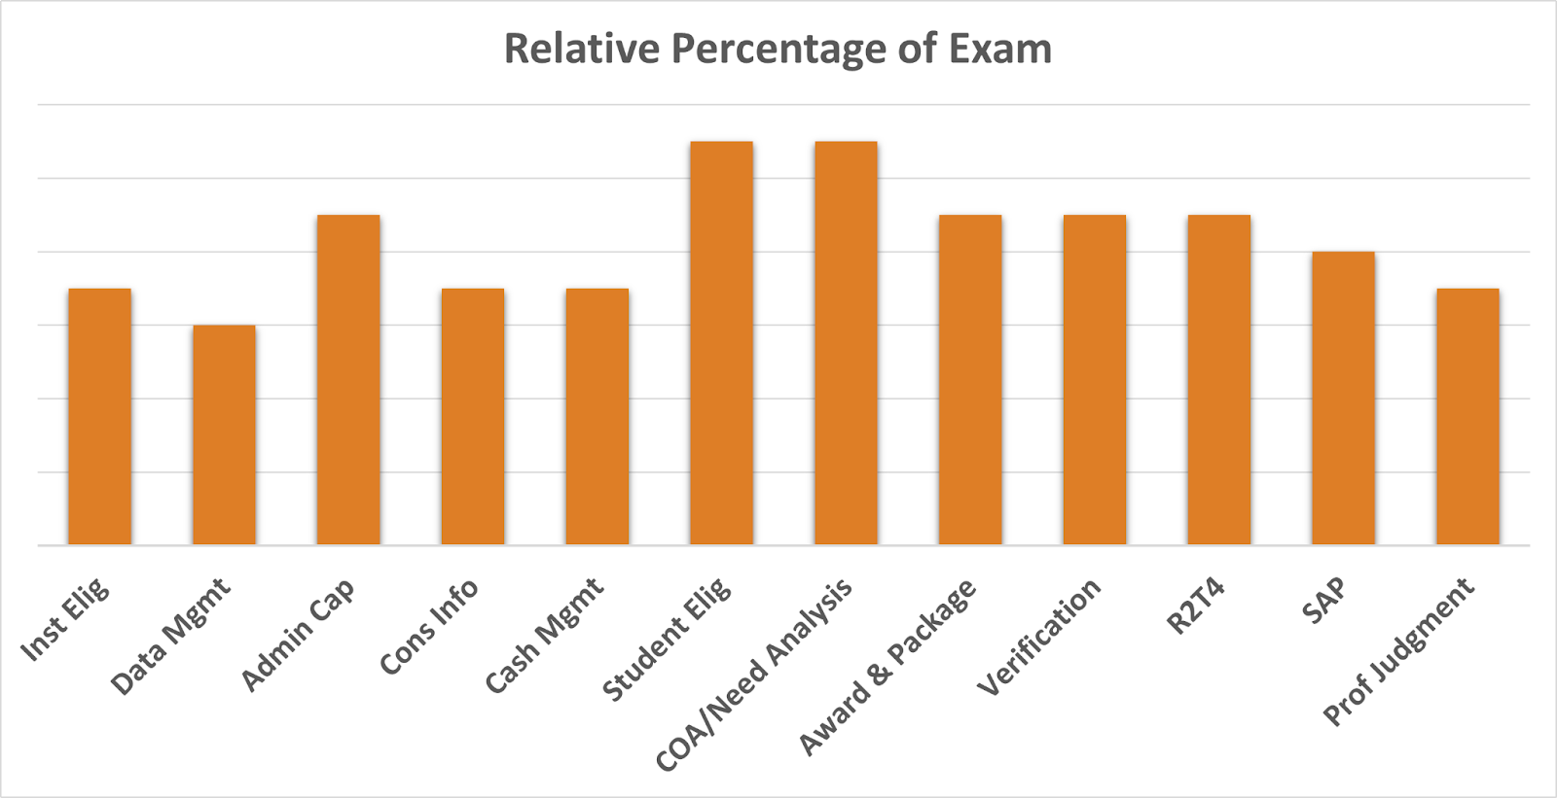
Essential Competencies
Notes:
Essential Competencies
This is a good time to talk about what’s covered on the exam. The composition of the exam is guided by extensive research on the job competencies performed and knowledge needed by financial aid administrators. Our subject matter experts divided the content into 12 main areas. These essential competencies are described in the exam content outline in the Candidate Handbook, with the percentage range of the test devoted to each area in parentheses.
Let’s talk about a free resource designed to help you explore these competencies and develop your own strategy for exam preparation

Slide 13
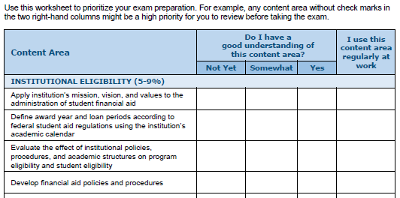
Self-Assessment Worksheet
Free to all candidates
Evaluate your readiness
Focus your review where it matters most
Key resources:
Notes:
Self-Assessment Worksheet
This worksheet is available to everyone for free. It helps you explore each content area – or essential competency – on the exam.
Use this worksheet to identify what these content areas are and to pinpoint the areas where you might have limited experience or knowledge. We recommend reviewing the outline and asking yourself “Do I have a good understanding of the content area” and “Do I use this knowledge regularly at work?” and then focusing your preparation on the areas you may not be as familiar with.
Using this worksheet, you’ll gain a sense for how much prep time you’ll need before you take the exam. This is where you can be strategic! Do you want to spend time preparing first, before you apply to the program? Or do you want to apply, and then use some of your one-year eligibility period to prepare? Or maybe you’re ready to apply and book your exam right away because the worksheet helped boost your confidence and now you’re ready to go! The key is to find the strategy that will work best for you.

Slide 14
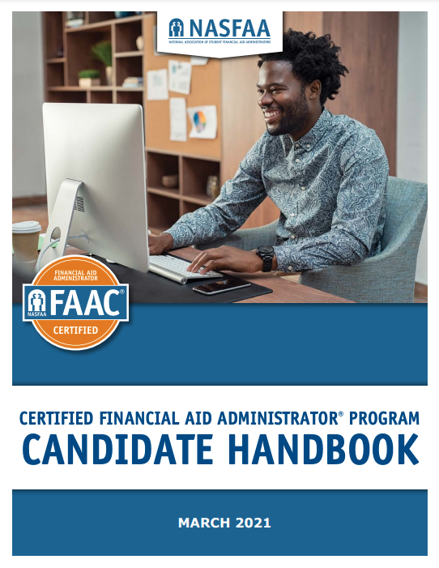
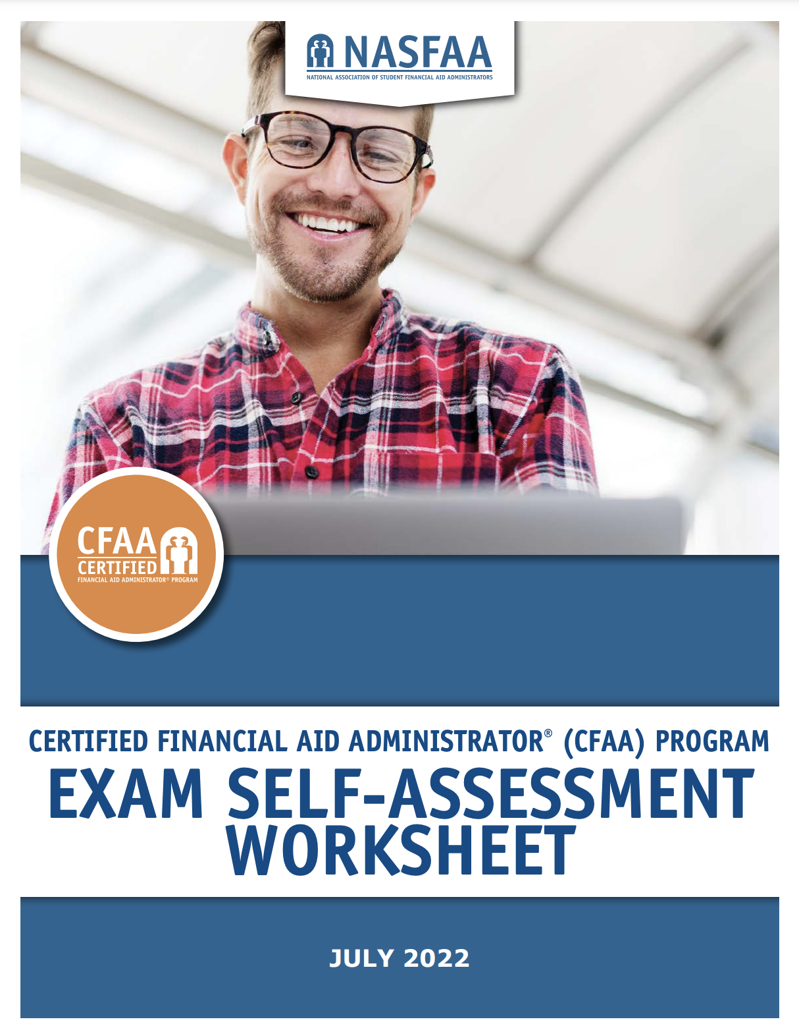
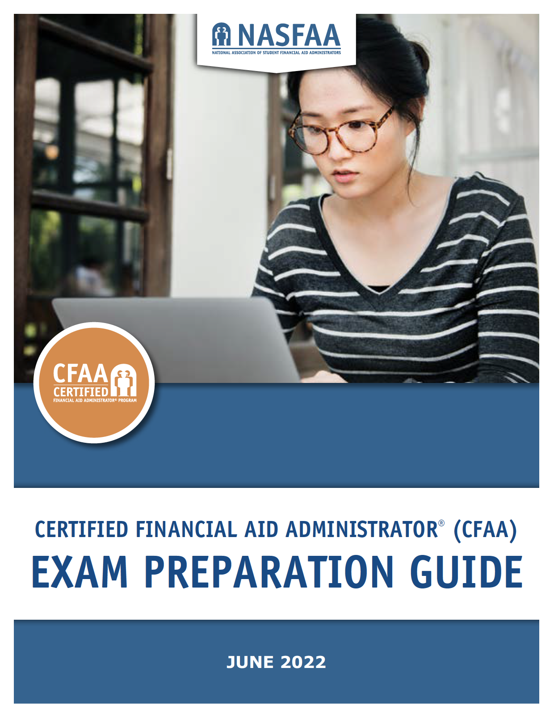
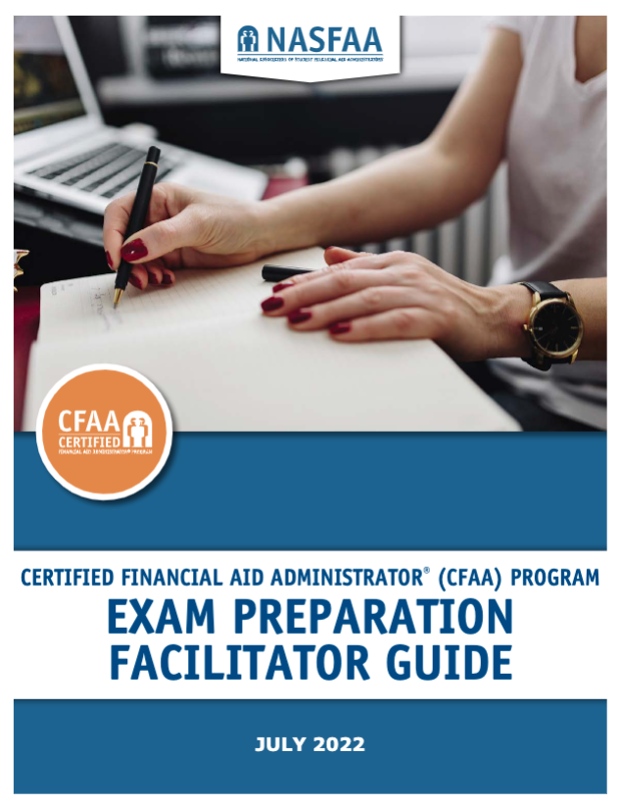
Preparation Resources
Your go-to resource!
Evaluate your readiness
Supplement your knowledge
Associations can help you prepare with your peers
Notes:
Preparation Resources
These resources help you to prepare for the exam.
The Candidate Handbook is also free and is your primary resource as you get ready to become certified. It covers everything from what’s on the exam, to how to apply, to technology requirements for the exam, to how and when you’ll recertify.
As I just mentioned on the last slide, the free Exam Self-Assessment Worksheet helps you gauge how soon you’ll be ready for the exam.
NASFAA’s Exam Preparation Guide is useful in preparing to be a financial aid administrator, as well as for preparing to take the knowledge exam. Each lesson covers concepts directly relevant to the administration of Title IV aid, within the scope of the twelve major content areas in the Exam Content Outline. It includes assessments to gauge both knowledge and application of principles. Designed for use in conjunction with other generally available resources, including regulatory guidance provided by the U.S. Department of Education, the information will complement and enhance the knowledge you already have.
MASFAA (our midwest regional association ) and your own state associations also offer training workshops based on the Exam Prep Guide and their own resources. NASFAA’s Facilitator Guide helps our state and regional associations design workshops and study groups. In fact, these trainings serve as key core for much of our summer institute that is held annually in June.
Question - How did you prepare for the knowledge exam?

Slide 15
NASFAA’s Professional Credentials
NOT required to pass the certification knowledge exam
Credentials demonstrate depth of knowledge in 16 topics
Multiple pathways
NASFAA Self-Study Guide
NASFAA U Online Course
Professional Experience
NASFAA Authorized Event
Notes:
NASFAA Professional Credentials
NASFAA also offers Professional Credentials and these can be a helpful way to prepare for the knowledge exam, especially in areas you’re less familiar with. While NASFAA professional credentials are not required if you already have five years or more of experience, we are seeing that candidates with five or more credentials have a higher success rate when taking the certification exam.
The key difference between these credentials and the certification is that credentials take a deeper dive into each of 16 different subject areas, compared to the certification program which requires greater breadth of knowledge.
You can qualify to take a credential through any one of several different pathways.
By the way, once you become certified, you can continue to earn or renew your credentials and earn recertification points for credentials you earn or renew.

Slide 16
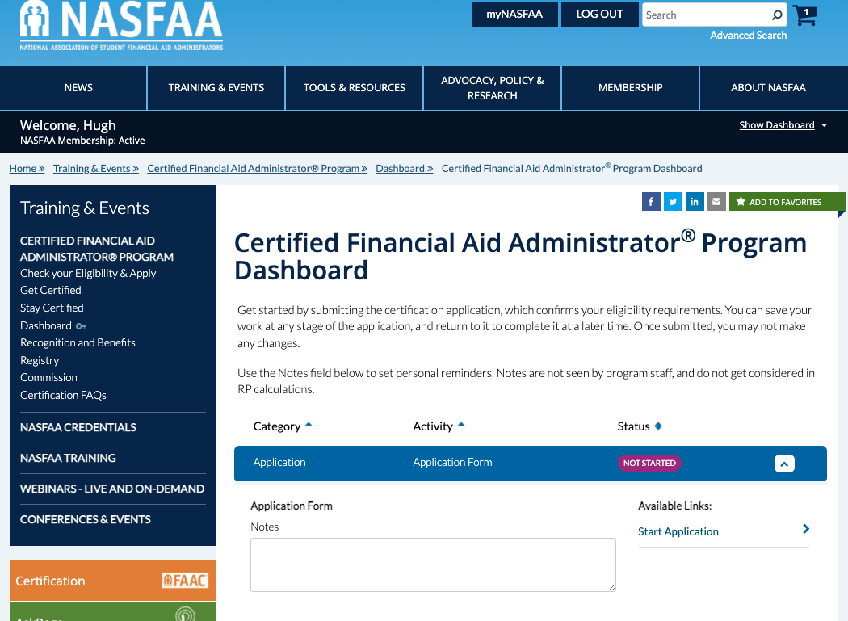
Apply Online
Notes:
Apply Online
Once you’re ready to apply, your next stop is your personal certification dashboard. This is your landing page for all things related to being an FAAC.
It’s easy to apply online and you typically get a response within a matter of days. Once approved, it’s also easy to purchase and schedule your exam for any testing window within your one-year eligibility period after your application is approved. You’ll receive all the instructions you need, and the certification team at NASFAA is standing by to help.

Slide 17
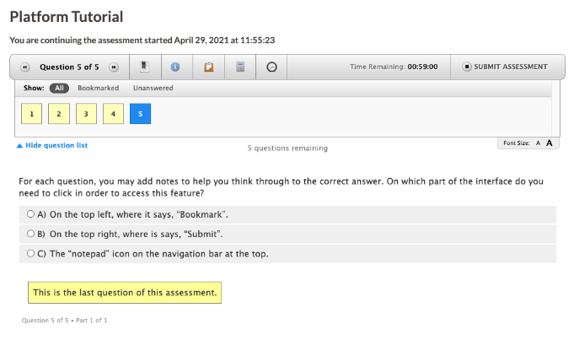
Taking the Certification Knowledge Exam
Approximately 115 multiple choice questions
Proctored remotely
Two hours
Platform tutorial
Multiple testing windows throughout the year
Notes:
Taking the Certification Knowledge Exam
The exam itself is a closed-book multiple-choice exam. It’s administered online using remote proctors, and you’ll have up to two hours. This means you can take the exam from your campus, or even from home as long as your setup meets the technical requirements.
A quick platform tutorial helps you learn how to use the testing center platform, which is very intuitive and user-friendly.
You’ll have multiple testing windows to choose from throughout the year. Just make sure to take your exam within your one-year eligibility window that begins when your application is approved. You can re-take the exam if you need to, for a fee, just not during the same testing window. So don’t schedule your first attempt during the last testing window in your eligibility period, just in case!
Panel Question – What was your testing experience like?

Slide 18
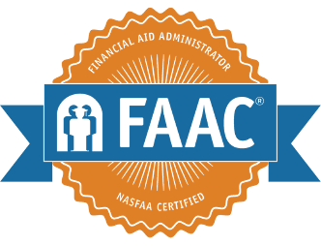
Congratulations, you passed!
Inclusion on the CFAA Program Registry
Add the “FAAC®” acronym to your name
Digital badge from Badgr
Certificate and Lapel Pin from The Award Group (TAG)
Join the FAAC Community on Slack
Notes:
Congratulations, you passed!
If you meet the eligibility requirements and take time to prepare using the approach I just outlined, you’ll likely receive a congratulatory email immediately upon completing your exam!
You’ll find out your results immediately. All exam outcomes are held in confidence. NASFAA honors those who were successful by publishing the names and institutions of everyone who earns the certification in the Registry, which is available online.
Once you’ve passed the exam, you can add the FAAC® acronym to your name, adding that additional level of credibility we discussed earlier. You’ll be able to highlight your achievement on social media with your digital badge, and in your office with your new certificate and lapel pin. And most importantly, you’ll have the opportunity to connect with fellow FAACs through the community!

Slide 19
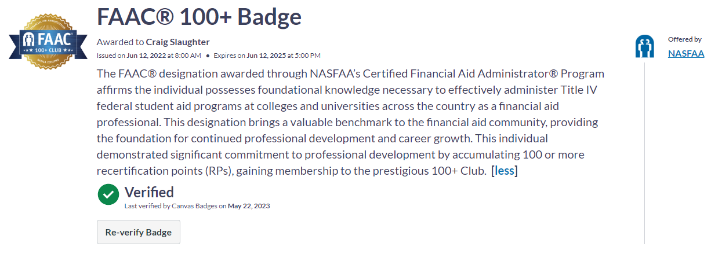
Digital Badge

Slide 20
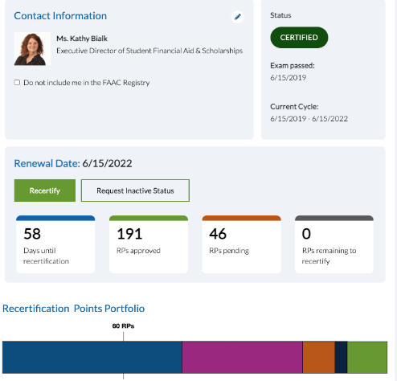
Maintain Your Certification
FAACs recertify every three years from original exam pass date
No exam needed to recertify!
Earn at least 60 RPs through continuous learning and professional growth activities
Leverage your need to recertify to justify investment in training
Sample FAAC®
Title of User
Notes:
Maintain Your Certification
You need to maintain your FAAC designation by recertifying every three years. Recertification is the most important phase of the program because it demonstrates that you are keeping your knowledge up to date, and that you’re continuing to engage in activities that support your long-term professional development and personal growth as a financial aid administrator.
I want to emphasize that you will not need to take the exam again, as long as you recertify before the end of your three-year recertification period. What you will need to do is earn recertification points (RPs) for activities related to your work in financial aid. Many of these activities are likely things that you’re already doing (like attending a CONFERENCE which awards 6 RPs). You can view the list of activities online, even before you become certified, and plan from the beginning what your strategy will be for earning at least 60 RPs every three years.
You might be able to leverage your certification to create even more opportunities. FAACs have told us that the need to recertify helped them to get approval to attend training events and conference, and other opportunities such as leadership positions in their regional and state associations.
Panel Question – What was your recertification experience like?

Slide 21
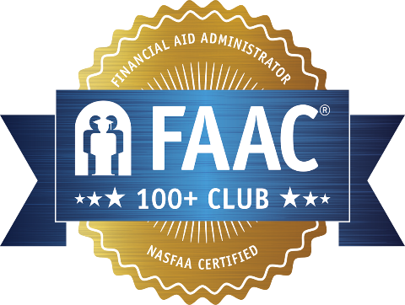
Join the 100+ Club
Special digital badge
Earn the 100+ Club lapel pin
Inclusion on the 100+ Club Registry
Enhanced announcement letter
Discount on recertification
Notes:
Join the 100+ Club
FAACs who recertify with 100 or more RPs qualify to join the 100+ Club! A major benefit for this level of recertification is the 40% discount that is applied to the recertification fee, as well as additional opportunities and special recognition.

Slide 22
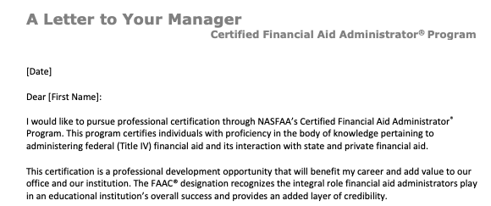
Make the Investment
nasfaa.org/certification_justification
Notes:
Make the Investment
NASFAA prepared a customizable justification letter for those interested in pursuing the FAAC designation. You can share this with managers and leadership at your institution to help explain the Program and encourage them to support your participation.
They have also prepared a customizable justification letter to request support for recertification, when the time comes.

Slide 23
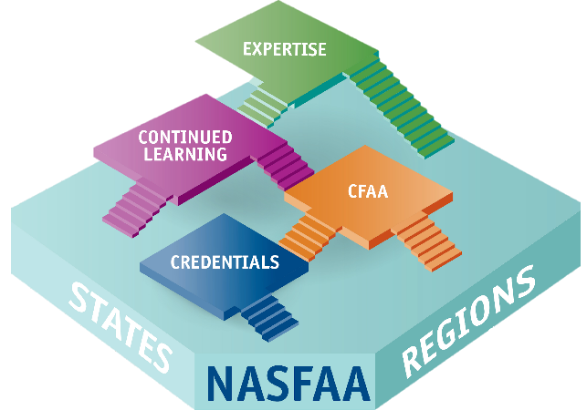
It’s More Than Just An Exam…
Certification is one part of a professional development ecosystem
Notes:
It’s More Than Just An Exam…
The CFAA Program builds upon the foundation of the work that you already do as a member of the financial aid community.
You begin accumulating knowledge and experience by working in the financial aid office, creating a solid foundation. You’re supported along the way by your state, regional, and national professional associations, through conferences, workshops and training events, and even mentoring by your peers.
You can follow any one of multiple pathways to becoming a financial aid expert leader… and the FAAC designation is just one step on your pathway toward expertise! The great thing is that you get to decide what your path to expertise looks like.
The opportunity you have now is to get recognition for what you’ve learned as you go… like milestones on a long journey. I want to point out that being an FAAC doesn’t mean that you’re a financial aid expert. The CFAA Program is meant to be part of your journey, and it shouldn’t stop there. The journey most certainly includes continuing education, which is part of the Recertification requirements.

Slide 24
Get Certified
Community
Credibility
Continued Learning
Notes:
Get Certified
So get certified as an FAAC and get ready to join a vibrant community of your peers who share your passion and commitment to financial aid administration. You’ll become a part of a strong network of professionals who have demonstrated their knowledge and proven their experience. Within this community, you can seek guidance, mentorship, and friendship. You will continue to grow and learn within a distinguished community of like-minded and skilled financial aid professionals.

Slide 25
Questions?
Ask your questions today
Email certification@nasfaa.org
Notes:
Questions? [
So what questions do you have? I’ll do my best to answer them here or follow up with you later. You can also send in your specific questions to certification@nasfaa.org
Do I need to get all of the credentials first?
No, you can become an FAAC without earning any of NASFAA’s credentials as long as you have at least 5 years of experience; however, statistically speaking, we’re seeing a correlation between success on the exam and having earned at least five credentials.
Do I have to be working in the financial aid office to qualify? What if I know financial aid but I work in another office?
You could become an FAAC even if you’re not currently working in a financial aid office, as long as you have the minimum experience that’s required. As you would expect, it’s very difficult to pass the exam without prior experience working in a financial aid office.
If I don’t have a bachelor’s degree, but I have lots of FA experience, can I get the FAAC?
No, unfortunately. A certification candidate must hold a bachelor’s degree or higher from an accredited institution of higher education, a criterion that was considered very carefully when designing this program. A bachelor’s degree is required due to the environment within which certified FAAs move, higher education. This requirement is supported by data collected in NASFAA’s Benchmarking Report and the certification Job Task Analysis Survey, which found that the vast majority – 96% or greater – of financial aid professionals hold at least a bachelor’s degree. The Commission and NASFAA Board both support this eligibility requirement.
How much does it cost? Is there a fee to renew?
The fees are outlined in the Candidate Handbook and online (https://www.nasfaa.org/certification_fees). Currently, the application fee is $50, the exam fee is $375, and the recertification fee is $300 once every three years. This certification is priced fairly and competitively compared to other professional certification programs.
Do I have to be a NASFAA member to participate?
No. Nonmembers are welcome to participate!
[Note: refer applicants with questions to certification@nasfaa.org]

