Slide 1
Verification
Reflecting on the Past, Celebrating the Present, Shaping our future together.
2023 Conference
Ruth Carlson – Bay College
Louie Krause – Wayne State University

Slide 2
Resources
Application and Verification Guide
Chapter 4 – Verification, Updates, and Corrections
ED.gov – Program Integrity Questions and Answers – Verification
Internal Revenue Service (IRS) Online
IRS Publication 17 (2021)
Federal Register
AskRegs
2023-24 Tax Transcript Decoder
Your schools Policies and Procedures

Slide 3
What is Verification?
Verification is a qualify control process used by the institution/DoE to check for accuracy of FAFSA data
Purposes:
Reduce error rates in applicant reported data
Ensure eligible applicants receive correct amount of federal financial assistance

Slide 4
Major Changes to the 2324 FAFSA
Removal of Selective Service view
Removal of drug conviction questions and worksheet
Removal of associated help text, validation logic, edits, comments, and messaging related to Selective Service and drug conviction questions
Addition of a demographic survey with questions related to gender, ethnicity, and race

Slide 5
Common Terms
DRT
IRS
W2
ISIR
WTB
1040
TRT
HS Diploma
Conflicting Info
AGI
Taxes Paid
Dependency
Martial Status
Reject
C-Codes
NWC
Household
Number in college
Verification Group
Statement
VNF

Slide 6
Verification Tracking Groups
V1
Standard
Tax filer income information
Nontax filer income information
Household size
Number in college

Slide 7
Verification Tracking Groups
Identity and Statement of Educational Purpose
V4
Custom

Slide 8
Verification Tracking Groups
V5
Aggregate
Tax filer income information
Household size
Identity and Statement of Educational Purpose
Nontax filer income information
Number in college

Slide 9
OG Verification Groups….
Who remembers these?
V2: ??
V3: ??
V6: ??
Notes:
Verification Group (V1)
SNAP Verification Group (V2)
Child Support Paid Verification Group (V3)
Custom Verification Group (V4)
Aggregate Verification Group (V5)
Household Resources Group (V6)

Slide 10
Income Verification: Tax Filer
Adjusted Gross Income (AGI)
U.S. Income Tax Paid
Untaxed Portions of IRA Distributions
Untaxed Portions of Pensions
IRA Deductions and Payments
Tax Exempt Interest Income
Education Credits

Slide 11
IRS DRT Cannot Be Used When…
Tax return not yet filed
Puerto Rican or foreign (non-U.S.) tax return filed
Taxes filed electronically within last 3 weeks
Taxes filed by mail within last 11 weeks
Parents are unmarried and living together
Change in marital status after end of tax year and before filing FAFSA
Conflict between marital and tax filing status
Married independent student and spouse filed separate tax returns
Married parents filed separate tax returns
Married and filed taxes as head of household
First 3 digits of Social Security Number (SSN) are “666”
Neither married parent has a valid SSN
Both parents entered all zeros for SSN

Slide 12
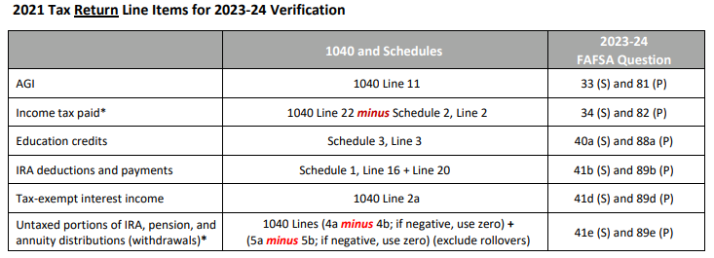
Using 1040 to Verify
Page 3 – Tax Decoder

Slide 13
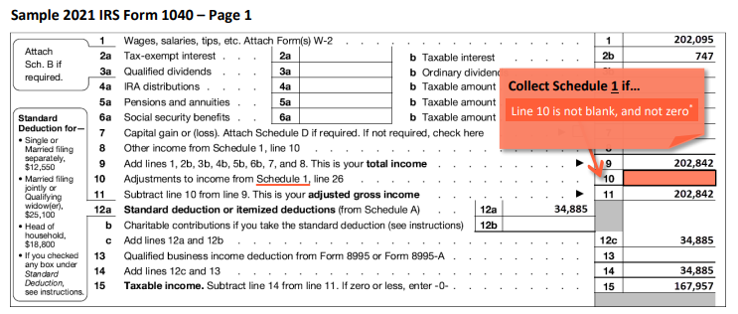
How to know if a Schedule 1 is filed?
Page 31 – Tax Decoder

Slide 14
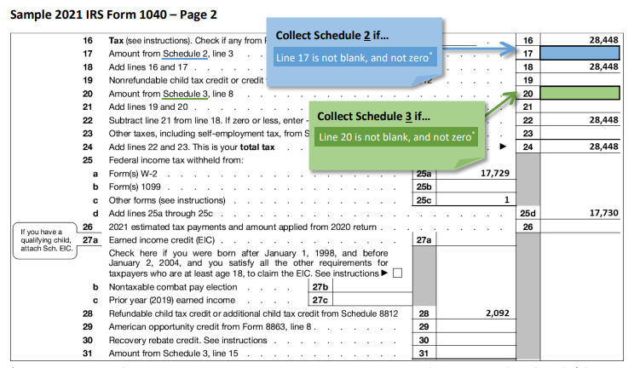
How to know if a Schedule 2 or 3 are filed?
Page 31 – Tax Decoder

Slide 15
How do you know if we need schedules?
Note: There are instances when Schedule 1, 2, or 3 was filed, but you do not need a copy of that schedule for federal verification purposes unless there is conflicting information. If any of the following line items are the sole reason the taxpayer filed the schedule, you do not need to collect a copy of that schedule:
Schedule 1, Line 8
Schedule 2, Line 23
Schedule 3, Line 31

Slide 16
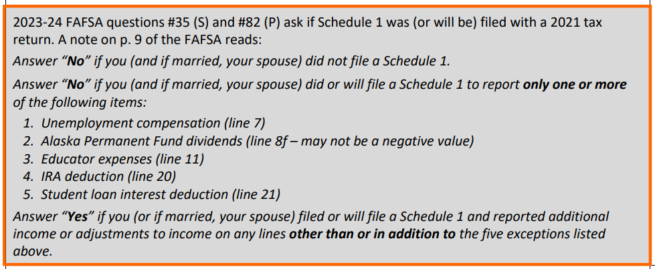
How do you know if we need schedules?

Slide 17
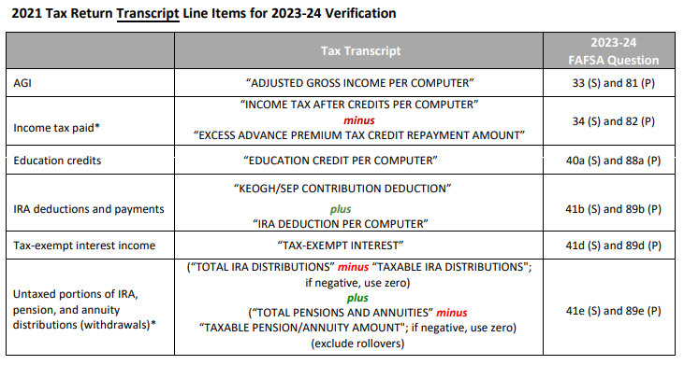
Using TRT to Verify
Page 3 – Tax Decoder

Slide 18
Income Verification: Non-Tax Filer
V1/V5 students:
Copy of W2(s) from each source of employment
If no W2 - Signed statement giving the source/amount of income earned
Signed statement certifying the person has not and is not required to file taxes
VNF or signed statement (dated after 10/1/22) stating they attempted but were unable to get a IRS VNF letter

Slide 19
Household Form
To document the household size, the student needs to provide a statement signed by him or her and, if dependent, at least one parent that gives the name, age, and relationship to the student of each person in the household.
Verification is not required:
Dependent student:
HH size = 3 and parents married or unmarried but living together
HH size = 2 and parent single, divorced, separated, or widowed
Independent student:
HH size = 2 and student is married
HH size = 1 for single, divorced, separated or widowed student

Slide 20
Number in College
To document the household size, the student needs to provide a statement signed by him or her and, if dependent, at least one parent that gives the name, age, and relationship to the student of each person in the household (exclude parent(s) in number in college).
Verification is not required:
Dependent student:
HH size = 3 and parents married or unmarried but living together
HH size = 2 and parent single, divorced, separated, or widowed
Independent student:
HH size = 2 and student is married
HH size = 1 for single, divorced, separated or widowed student

Slide 21
Identity/Statement of Education Purpose
Verifying that the student:
Are they who they claim to be
Will use Title IV funds only for educationally-related expenses
Need:
Unexpired valid Government Issued ID
Statement of Educational Purpose/Identity Verificaiton
Signed in the presence of office or notarized
Notes:
These are always verified together
You must use the exact language given by DoE

Slide 22
Verification Exclusions
Death of a student: You don’t have to continue verification if you made an interim disbursement and the student died before verification was completed. You cannot make any additional disbursements, except for FWS funds already earned, to any of the student’s beneficiaries
Not an aid recipient: The student won’t receive Title IV aid for reasons other than failure to complete verification
Only eligible for Unsub: However, students selected for V4/V5 would still need to complete the verification process
Post enrollment: The student was selected for verification after ceasing to be enrolled and no further (including late) disbursements will be made
Student verified by another school: The student completed verification for the current award year at another school before transferring. Data must be the same and new school must get a letter from previous school stating they verified the students FAFSA and provides the transaction number of the valid ISIR

Slide 23
Verification Exclusions (Con’t)
Unless we have reason to believe it is inaccurate, we don’t have to verify reported FAFSA information:
Parents of Dependent Student:
Both parents are mentally incapacitated
Both parents/ custodial parents have died
Residing in another country and cannot be contacted by normal means
Can’t be located and student cannot get their contact information
Spouse of Independent Student:
Spouse has died
Spouse is mentally incapacitated
Spouse is residing in another country and cannot be contacted by normal means
Can’t be located and student cannot get their contact information

Slide 24
Special Situations
Filing extensions
Need:
Copy of IRS approval for extension beyond the automatic 6 months
Verification of non-filing
Copies of all their W2s
Self-employed: a signed statement with the amounts of their AGI/US taxes paid
Amended returns
Need:
Signed 1040X
IRS DRT, 1040, or TRT with original tax information that needs to be verified
Victims of identity theft
Need:
Tax Return Database View (TRDBV)
Signed/dated statement indicating they were victims of tax-related identify theft

Slide 25
Splitting Joint Taxes
If the of a joint return has become widowed, divorced, or separated since filing the return, it may be necessary to determine the individual’s income and taxes paid using the joint return and W-2 forms.
Need:
2021 Taxes (and schedules)
2021 W2s
Other? (i.e. 1099-G, 1099-MISC, etc.)
Then “rework” the 2021 taxes using the income/asset information for the surviving spouse or custodial parent.
To determine taxes paid:
Tax table (preferred method): in reworking taxes, you would then use the tax table to determine taxes paid
Proportional distribution: determine what percentage of the joint AGI was attributed to the individual and then assess the joint taxes paid by the same percentage
Annual Limits | Dependent Student (1) | Independent Student(2)
1st-year undergraduate | $5,500 (maximum $3,500 subsidized) | $9,500 ($3,500) (3)
2nd-year undergraduate | $6,500 ($4,500) | $10,500 ($4,500)
3rd- and 4th-year undergraduate | $7,500 ($5,500) | $12,500 ($5,500)
Graduate/professional | NA (All graduate and professional students are considered independent.) | $20,500

Slide 26
Potpourri
EFC formula used may change after making corrections so follow-up for assets may be needed
Duplicate income/asset info for parent/student
Negative wages and/or business income is treated as 0 for the purpose of wages on the FAFSA
W2s that are a couple dollars off from wages on taxes?
During the Federally declared national emergency, flexibilities were provided for verification. These flexibilities were available through the end of the payment period that begins after the date on which the national emergency is rescinded. For most schools, this will be the end of the Summer 2023 semester
Buckle up for 2024-25!
Annual Limits | Dependent Student (1) | Independent Student(2)
1st-year undergraduate | $5,500 (maximum $3,500 subsidized) | $9,500 ($3,500) (3)
2nd-year undergraduate | $6,500 ($4,500) | $10,500 ($4,500)
3rd- and 4th-year undergraduate | $7,500 ($5,500) | $12,500 ($5,500)
Graduate/professional | NA (All graduate and professional students are considered independent.) | $20,500

Slide 27
Questions?????
Ruth Carlson – Ruth.Carlson@baycollege.edu
Louie Krause – Louie.Krause@wayne.edu

