Slide 1
Your Title goes Here
2022-2023 Updates
SUBTITLE HERE
Notes:
Good afternoon everyone! Thank you for inviting me to your conference. I’m happy to be here today to provide you with a MASFAA update. Your conference committee has put together a great conference agenda, and I hope you are having an excellent experience.
I will talk a bit more about some exciting things that are happening with MASFAA, but first would like to encourage anyone that is a first time attendee to consider getting involved with your state association. While the thing I enjoy most about financial aid is the impact that I have in helping students attend school and graduate, I know that I would not be a successful Financial Aid Administrator without our professional associations. The relationships, friendships and networks that are developed through Financial Aid Associations are invaluable. The people I have met are much more than colleagues – they are close friends that I know I can call on at any time. They truly understand what we do and the challenges that we face. They are always willing to listen, share their thoughts and talk through problems. For that, I am truly grateful.

Slide 2
Financial Aid Association Structure
National Association
Regional Associations
State Associations
Notes:
Now a bit more about our professional associations. There are three levels of professional associations, the state level, the regional level, and the national level. Here in Indiana, your state association, as you know ,is ISFAA , your regional association is MASFAA, and the national association is NASFAA.

Slide 3
NASFAA
National Association of Student Financial Aid Administrators
Institutional-based association with professional staff headquartered in Washington, DC
Serves 2,800+ post-secondary institutions
Represents the interest of financial aid professionals and students to Congress, the Department of Education and other regulatory agencies
MASFAA Past-President serves on NASFAA Board, as well as designees from five other regional associations (EASFAA, SASFAA, SWASFAA, RMASFAA, and WASFAA)
Notes:
NASFAA represents the interest of financial aid professionals and students to Congress, Department of Education and other regulatory agencies. NASFAA has established six regional associations to provide a system of governance and to serve as a conduit for providing information to and from the national association and the state associations. MASFAA works with NASFAA to have your voice heard and represented in policy decisions.

Slide 4
What is masfaa?
A regional association of financial aid professionals from nine states…
Three M’s: Michigan, Minnesota, Missouri;
Three I’s: Illinois, Indiana, Iowa;
And a WOW: Wisconsin, Ohio, West Virginia
Notes:
So what is MASFAA? MASFAA is a regional organization representing 9 states. We refer to the 9 states as the 3Ms (Michigan, Minnesota, Missouri) the 3 I’s (Illinois, Indiana and Iowa) and WOW (Wisconsin, Ohio and West Virginia).

Slide 5
MASFAA
Is a conduit for providing information to/from NASFAA and states
Provides a larger network than typically available on the State level
Works with State Associations to provide services for the membership
Provides leadership/professional development opportunities that can also lead to NASFAA leadership opportunities
Relies on volunteers (versus paid staff)
Notes:
MASFAA is a group of individuals engaged in or concerned with the ethical administration and support of student financial aid. Our mission is to promote and provide quality training and professional development opportunities, advocate and support student financial aid programs, and facilitate effective communication and coordination among interrelated professional associations, thereby serving the needs and interests of students and postsecondary institutions.

Slide 6
Masfaa officers 2022-23
MASFAA Elected Position | Name | Institution
Past President/Nominations,Elections & AGPC chair | Heidi Carl | Purdue University
President | Craig Slaughter | Kenyon College
President-Elect | Amanda Fijal | University of Chicago
Vice President/Finance chair | Nathan Lohr | University of Indianapolis
Treasurer | Betsy Johnson | Bowling Green State University
Treasurer-Elect | Emily Haynam | University of Missouri
Secretary | Renae Armentrout | Coe College
Delegate - Y1 | Laura Rogers | University of Chicago
Delegate - Y1 | Manda Riley | University of Missouri
Delegate - Y2 | Alisha Cederberg | Kalamazoo Valley Community College
Delegate - Y2 | Melissa VanMeter | Ohio University
MASFAA State Reps
Illinois | Elyse Weller | Southern Illinois Univ- Carbondale
Indiana | Megan Watson | Ind U/Purdue U- Indianapolis (IUPUI)
Iowa | Brandi Miller | Drake University
Michigan | Louie Krause | Wayne State University
Minnesota | Amanda Cantù | University of St. Thomas
Missouri | Matthew Kearney | Southeast Missouri State University
Ohio | Jayme Jarrett | Ohio Northern University
West Virginia | Candi Frazier | West Virginia University
Wisconsin | Mandy Slowinski | University of Wisconsin- Stevens Point
Notes:
[Highlight representatives from the state who are serving on the MASFAA Board]
Your elected officers from Michigan include Alisha Cederberg and Louie Krause.

Slide 7
MASFAA Committees & Task Forces 2022-23
State Representative Liaison | Sue Swisher | St. Xavier Univ |  | Inclusion, Diversity, Equity & Access (IDEA) | Christopher Johnson | Univ of Chicago
AGPC Past President Rep | Michelle Trame | Univ of Illinois - Urbana/Champaign |  | Inclusion, Diversity, Equity & Access (IDEA) | Brian Drabik | Northwestern Univ
Strategic Long Range Plan | Cori Splain | Univ of Wisconsin - Madison |  | Mentoring Task Force | Amy Hager | Moberly Area Comm College
Strategic Long Range Plan | Buddy Mayfield | NW Missouri State Univ |  | Mentoring Task Force | Krissy Bhaumik | Univ of Michigan - Ann Arbor
Associate Member Relations | Anne Dahlen | Mayo Clinic |  | Professional Development | Shashanta James | Western Michigan Univ
Conference Site Selection | Dick Battig | Model College of Hair Design |  | Professional Development | Danielle Hayden | Carleton College
Conference Site / AGPC Rep | Chad Olson | Iowa State Univ |  | Summer Inst/Leadership Symp | Ryan Czech | Northwestern Univ
Electronic Services | Karla Weber Wandel | Univ of Wisconsin–Madison |  | Summer Inst/Leadership Symp | Monica Taylor | Indiana Univ- Bloomington
Membership & Engagement | Daniel Matamoros | Loyola Univ Chicago
Research & Archives | Michael Crider | Dakota Technical/Inver Hills CC
Awards | Melinda Middleton | Rose Hulman Univ
Conference Program | Heidi Johnson | Univ of Wisconsin - Madison
Conference Program | Keri Gilbert | Stephens College
Conference Local Arrangements | Alex DeLonis | Wabash College
Conference Local Arrangements | Lisa Bridgewater | Ind U/Purdue U- Indianapolis (IUPUI)
Notes:
In addition to officers, we also have Shashanta James representing Michigan as a Committee chair.

Slide 8
MASFAA 2020-23 Strategic Plan
VISION STATEMENT
The Vision for MASFAA is to be the recognized leader in providing networking, professional development, resources, and engagement opportunities for financial aid administrators by leveraging its distinctive role as regional association to meet diverse member needs and foster professional collaborations.
Notes:
As part of our last strategic plan, the MASFAA board adopted a new Vision and Mission Statements in 2019 that read as follows…
The Vision for MASFAA is to be the recognized leader in providing networking, professional development, resources, and engagement opportunities for financial aid administrators by leveraging its distinctive role as regional association to meet diverse member needs and foster professional collaborations.

Slide 9
MASFAA 2020-23 Strategic Plan
MISSION STATEMENT
Serve and promote the financial aid needs and interests of students and postsecondary institutions;
Provide regional leadership in advancing financial aid knowledge and capabilities of members; and
Offer engagement, professional development, and leadership opportunities for members.
Notes:
The Mission of MASFAA is to:
Serve and promote the financial aid needs and interests of students and postsecondary institutions;
Provide regional leadership in advancing financial aid knowledge and capabilities of members; and
Offer engagement, professional development, and leadership opportunities for members.
As you can see, our strategic plan extends through 2023. This year’s board is charged with updating the strategic plan to take us into 2026 and beyond…

Slide 10
MASFAA Membership Structure
INSTITUTIONAL MEMBERSHIP
Institutions and associate member organizations hold the membership, but can add anyone from that institution or organization to their membership roster
Each institution pays a membership fee on a sliding scale based on student Full Time Enrollment (FTE) reported to IPEDS
Each associate member organization pays a flat membership fee regardless of the number of individuals listed on their roster
Each institution and associate member organization partner designates ONE individual from their institution/organization to vote
Retired members do not have voting rights
Notes:
At the October 2019 Annual conference the membership voted to change the membership structure from individual to institutional membership. Under this model, your entire institution can join MASFAA under one competitive price based on institutional FTE. The current rates are $175 for institutions below 5,000 FTE, $325 for institutions below 15,000 FTE and $475 for institutions at 15,000 FTE or higher.

Slide 11
Benefits of Institutional Membership
Increases the reach MASFAA has to active financial aid professionals in the region by allowing all individuals at member institutions access to participate in MASFAA activities
In the past an institution that before may have had only one member will now be able to add multiple members from the institution
Some schools will only cover the cost of membership if it is institutional rather than individual, so this move allows fewer hurdles for some institutions to join
MASFAA is following a national trend of other regional financial aid associations that are moving to institutional membership
Notes:
In the past, under the individual membership model, institutions with limited budgets for membership dues had to be very selective about whom they would support to join MASFAA. Often, the choice was contingent on if the individual was attending the conference or some other training event.
With the switch to institutional membership, everyone at the institution is now a member and has access to the resources and can elect to volunteer for committees, run for office and engage in other professional development opportunities.

Slide 12
Membership statistics (By type)
Membership Type | Bundle Count | Member Count
Associate Member Organization | 27 | 91
Lifetime | 6 | 6
Retired | 3 | 3
Student Enrollment 1-4,999 | 52 | 221
Student Enrollment 5,000-14,999 | 36 | 423
Student Enrollment 15,000 or more | 36 | 883
Total | 151 | 1,627
As of February 1, 2023
Notes:
In terms of membership statistics, each “bundle” represents an individual institution or organization (or member in the case of the lifetime and retired categories). Bundle administrators can then add individuals to their institutional rosters in order to access MASFAA benefits and services.
We have 115 higher education institutions represented, 27 associate member organizations and over 1,600 individual members.

Slide 13
Membership statistics (by state)
Members by State
Bundles by State
State | Member Count
Wisconsin | 271
Indiana | 250
Ohio | 243
Michigan | 216
Illinois | 185
Missouri | 170
Minnesota | 95
Iowa | 81
West Virginia | 73
Other | 43
TOTAL | 1,627
State | Member Count
Indiana | 22
Missouri | 20
Ohio | 20
Wisconsin | 20
Michigan | 19
Illinois | 18
Iowa | 12
Minnesota | 9
West Virginia | 3
Other | 8
TOTAL | 151
As of February 1, 2023
Notes:
If we look at the data by state, this shows the number of members in total as well as the number of bundles. Wisconsin leads the pack in terms of individual member count and Indiana leads the pack in terms of bundles.

Slide 14
MASFAA Member Services
Website
MASFAA Matters Webinar Series
MASFAA Moments Newsletter
Mentoring Program - NEW
Summer Institute and Leadership Symposium
Listserv (Legislative Updates, Job Postings)
Social Media: Facebook, Twitter, You Tube Channel
MASFAA Me Up! Podcast
Career Development & Networking
Professional Training and Conferences
Notes:
I referenced the services that members have access to and they include
Website content
The monthly newsletter
The annual conference at the member rate
Our new MASFAA Mentoring Program
Our summer training and leadership development programs at the member rate
The listserv containing information on legislative updates, job postings and more…
Webinars and other training materials
The periodic “MASFAA Me Up!” podcast that debuted last year…
And a lot of fun networking with amazing colleagues across our region.

Slide 15
MASFAA State Leadership Award
The State Leadership Award is presented annually to recognize the outstanding leadership of a member from each of the 9 states within MASFAA.
The recipients, who must be current MASFAA members, must have made outstanding contributions to the financial aid profession at the state and regional levels over a sustained period of time, i.e., seven years or more.
Leadership at the regional level is not the only criterion for this award, and the selection process will not be limited to current state elected leaders.
The individuals selected for this award must exhibit high integrity and character; have shown creative leadership; have inspired and encouraged others to participate actively in professional development activities; have sustained active involvement in professional organizations, and have supported the goals and objectives of MASFAA
Notes:
Each year at the MASFAA Annual conference, we recognize a MASFAA member from each of the 9 states to receive the State leadership award for outstanding contributions to the profession.
Nominations come from the state associations and we present the awards at the annual MASFAA conference in addition to recognizing the recipients at the annual conference in their home states.

Slide 16
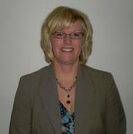
2021-2022 MASFAA State Leadership Award for MICHIGAN
Congratulations Stephanie Bogard-Trapp!
Senior Director of Financial Aid and Title IV Compliance,
Lansing Community College
Notes:
I am proud to acknowledge Indiana’s 2021-2022 recipient as…..
Stephanie Bogard-Trapp, Senior Director of Financial at Lansing Community College
Please join me in congratulating Stephanie for the leadership that she has shown representing MSFAA in supporting the important work that we do in our profession!
This recognition comes with a plaque and thunderous applause. Stephanie, please come up to receive your award.

Slide 17
RECENT TOPICS
FAFSA Simplification Roundtable
Affirmative Action in Higher Education
NASFAA Certified Financial Aid Administrator®
An Insider's Perspective of Negotiated Rulemaking
Check the MASFAA website for future topics…
https://masfaaweb.org/Webinars
Notes:
I mentioned the “MASFAA Matters” Webinar series earlier.
The volunteers on our professional development committee work hard to bring engaging content to members.
The professional development committee is hard at work developing the next set of topics and will post them on the website as soon as possible.
Some past topics that were presented include…
FAFSA Simplification Roundtable
Financial Literacy Roundtable
Working with Native American Students
An Insider's Perspective of Negotiated Rulemaking
Earlier this morning, a webinar was presented on the “Paying for College Transparency Initiative” presented by Alex Delonis, Justin Draeger, Derek Kindle and Megan Walter and additional excellent topics are planned for each month throughout the summer and early fall.
Please be sure to check the MASFAA Website and watch for listserv announcements about future topics and how to register.

Slide 18
MASFAA BOOK CLUB
https://masfaaweb.org/equality-talk-book-club
Notes:
In support of MASFAA’s diversity, equity and inclusion initiatives, we recently launched a book club called “Equality Talk” The plan is to read 3-4 books per year and gather together to discuss themes and how the readings can better inform the work that we do in our offices.
The mission statement for Equality Talk reads:
As leaders of the financial aid community, it is our goal and duty to help students obtain access to a college education and achieve their educational goals. By expanding our understanding of diverse groups, book club members will strive to think critically and inclusively to inform decision-making, the populations we serve, and our communities at-large.
The next book that will be read is titled, Demystifying Disability: What to Know, What to Say, and How to be an Ally scheduled virtually for June 15th.
Be sure to check the website and register for this next installment and join the conversation!

Slide 19
Summer Institute & Leadership Symposium
The Osthoff Resort and Conference Center
Elkhart Lake, Wisconsin
June 5-9, 2023
Notes:
Held annually, Summer Institute and Leadership Symposium are separate, but concurrent week-long training programs that give participants a chance to enhance their knowledge of financial aid, develop their professional and leadership skills, and engage with new and experienced financial aid administrators.
Summer Institute is geared for new professionals (typically 5 years or less) to teach the fundamentals of financial aid and prepare participants to sit for NASFAA Credential exams.
Leadership Symposium is designed to help cultivate future leaders for our state and regional associations and our profession as a whole.
This event will be held next week at the beautiful Osthoff Resort and Conference Center in Elkhart Lake, Wisconsin. It’s a really nice setting and excellent training opportunity.
Registration is closed for next week, but please stay tuned for the announcement of the 2024 Summer Institute and Leadership Symposium event.

Slide 20
Application Timeline
April 1: Application opens
May 31: Application deadline
June 30: Decisions sent to applicants
August: Program begins!
Goals
Develop strong leaders for our profession and associations
Encourage MASFAA Involvement
Engage mentees in professional development activities and trainings
Cultivate a sense of belonging in our professional community
Details
Ten-month experience (August – June)
Alternating seminars and mentor/mentee meetings
Culminating at Leadership Symposium
Interested professionals should have 3-12 years of experience in the profession
Notes:
MASFAA’s Mentoring Task Force developed a program with the Executive Board approved for 2023-2024.
The goals are to develop strong leaders for our profession and associations , encourage MASFAA Involvement , engage mentees in professional development activities and trainings, and to cultivate a sense of belonging in our professional community
Applications opened in April and close on May 31st. Stay tuned to the MASFAA Newsletter and Listserv for exciting details about how to apply and be part of the first cohort of mentors and mentees!
The 2023-2024 MASFAA Mentoring Program cohort will be limited in size to no more than 10 individuals; ideally each state in the MASFAA region will be represented. Selection to join this elite program will be based on the criteria specified on the application form. Applications are due no later than May 31, 2023. Notification will be made by June 30, 2023. Incomplete applications will not be considered.

Slide 21
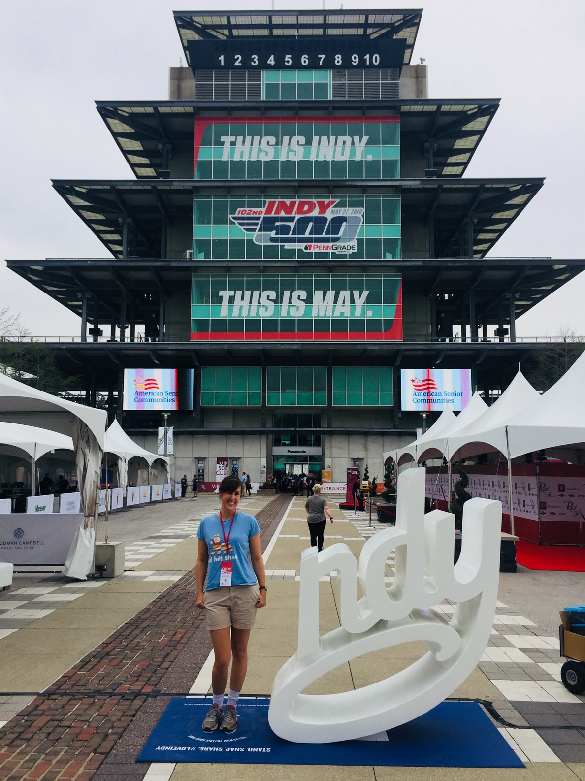
MASFAA 2023 Annual Conference
Sheraton Indianapolis Hotel at Keystone Crossing
October 22-25, 2023
Notes:
And finally, I invite all of you to come back to Indianapolis in October for the MASFAA Annual Conference where the conference theme will be “Ready, Set, Go” - a nod to the culture of racing here in Indy as well as a metaphor for our profession as we embark on the next chapter that includes FAFSA simplification other challenges and opportunities.
Some of you might remember that I have spent a lot of
The conference program committee is preparing engaging sessions and the local arrangements committee will ensure that we also have fun! Please mark your calendars and join us in Indy!

Slide 22
Join us in indy! October 22-25, 2023

Slide 23
Your Title goes Here
THANK YOU!
SUBTITLE HERE
Notes:
Thank you all again for the invitation to speak. If you have any questions, please come find me afterwards or send me an email.
Enjoy the rest of the conference!

